Slide 1
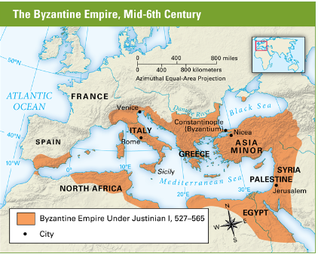
Byzantine Empire

Slide 2
Warm up
You are the newly crowned Roman Emperor. There are many problems facing the empire. On your half sheet of paper explain which problem you would seek to address first. Why would you address that particular problem first?

Slide 3
Rise of Byzantium- Objective
Historians will be able to describe the rise of the Byzantine Empire through a reading and response, and map activity.
Agenda
Byzantine Empire map and map analysis questions
Reading on the events that lead to the rise of the Byzantine Empire

Slide 4
Follow the directions on your worksheet to complete the map.
Directions

Slide 6
Map Analysis Questions
What do you notice about the Roman Empire?
By 500 what became of the western half of the Roman Empire?
What groups of people controlled these lands?
Why do you think the Eastern Roman Empire survived?

Slide 7
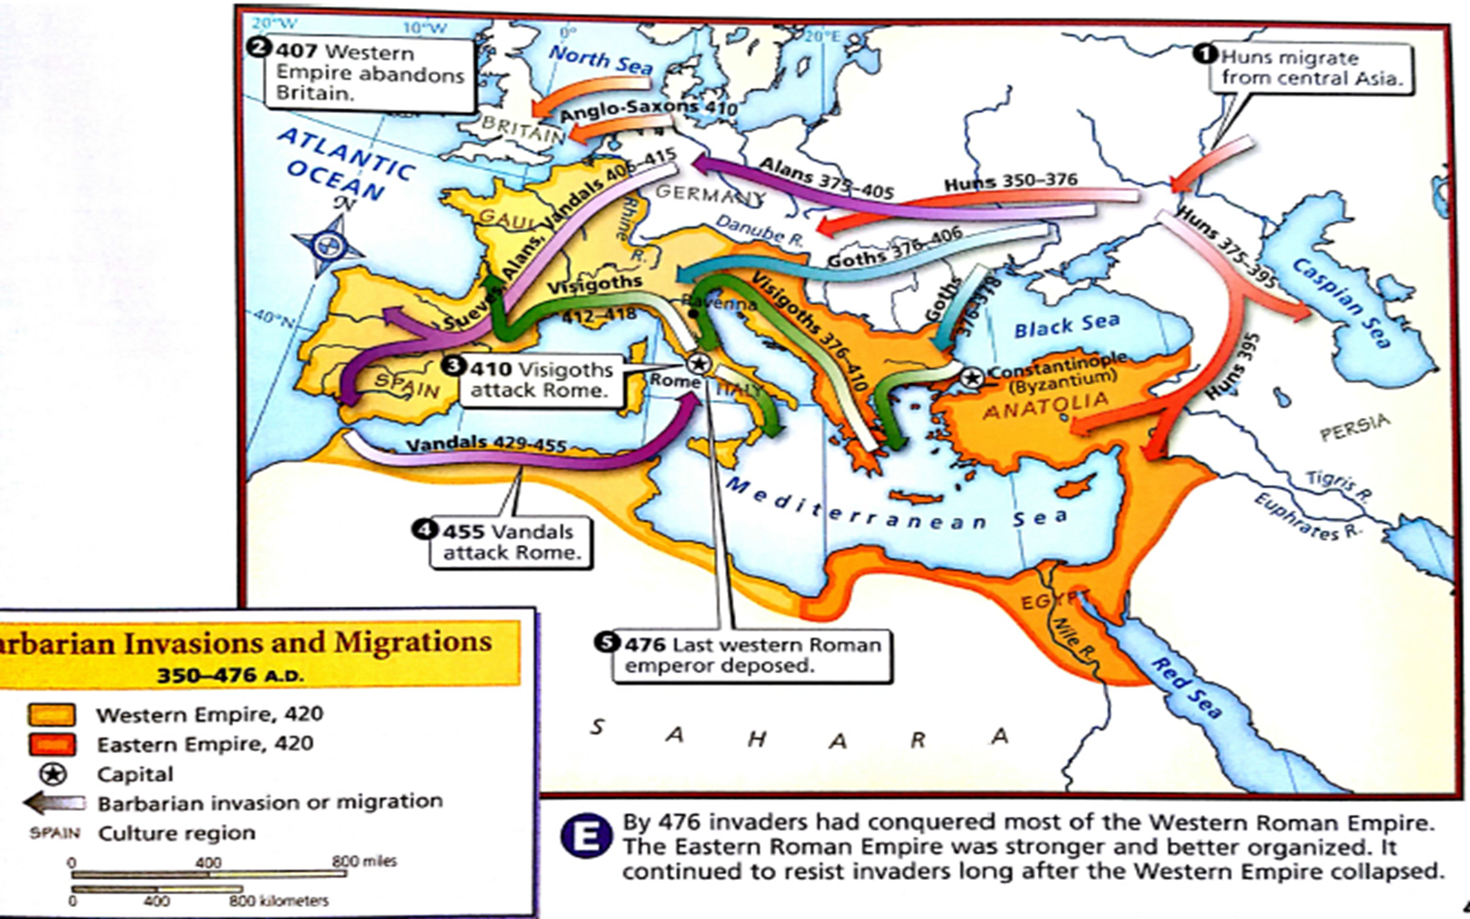
Rise of Byzantium Reading
Define barbarian:
Used to describe people from outside the empire who spoke a different language
Today it means someone who is uncivilized and warlike
The word vandal/vandalism comes from one barbarian group called the Vandals.

Slide 8
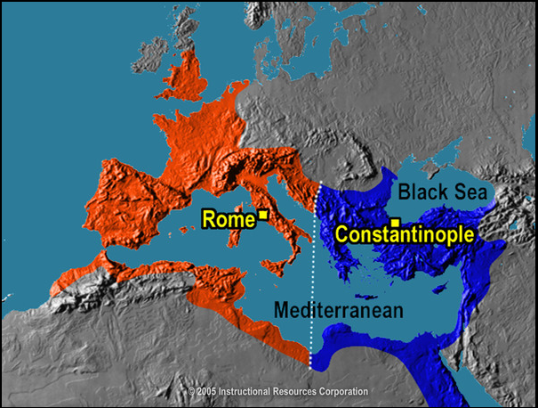
How did Diocletian rule the empire
He divided the empire into two parts (West and East) and had two men rule each half
He increased the size of the army to deal with invasions, but helped bankrupt the empire too
He hoped that these changes would protect the empire and make it easier to rule

Slide 9
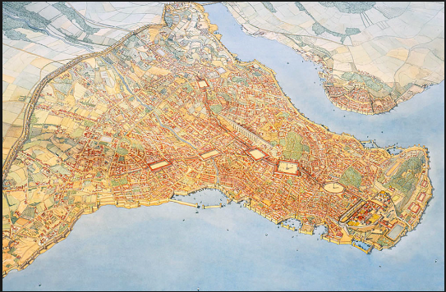
Constantine
When Emperor Constantine became emperor what attempts did he make at improving the empire?
He established his capital at Byzantium (later called Constantinople) to try and stabilize the empire.
Why did he move it there?
Constantinople was defended by water on three sides and mountains on a fourth. It was also a powerful trading center being on the edge of Europe and Asia.

Slide 10
Theodosius’ Will
When Theodosius died in his will he decreed that the Roman Empire would forever remain split into Eastern and Western halves.
Scholars refer to the eastern half as the Byzantine Empire
The western half the Roman Empire

Slide 11
Fall of Rome and Rise of Byzantium
The Roman Empire (western half) officially ended in 476 CE

Slide 13
Why did the Eastern Roman Empire survive?
Geography
Protected more by mountains and large bodies of water
Mountains allowed eastern armies to concentrate in certain areas unlike in the west
Close to trade routes which still kept the eastern half wealthy while the western half became more and more poor.
This allowed them to get needed supplies and money for an army and navy easier than western Romans

Slide 14
What lessons can we learn???
Good, steady leadership is important in surviving
Don’t mistreat your citizens
Its all about location, location, location
Byzantine……Constantinople

Slide 15
Constantinople
Historians will be able to explain why Constantinople was able to become a powerful city through a trading simulation and class discussion.
Warm Up:
Imagine you are a business owner looking to open a new store in Westminster. Brainstorm some places where you would get the most business from people.

Slide 16
Shark Tank: Constantinople
Each of you represent a trader from one of the seven towns shown
You will each have seven trade tokens, and must exchange them with other regions
The aim for each town is to accumulate the greatest variety (not quantity) of tokens, and the town with the greatest variety will win.

Slide 18
Rules of the Trade
1.Traders walk single file beside their path to enter the trading hub and single file on the other side to return home. They may not travel to other towns.
2.Trading is restricted to the trading hub and must be one token for one token. Trades can only be made with people from other towns.
3.Traders may carry only one token at a time.
4.When a trade is complete, traders take their merchandise home and pick up another token to trade.
5.Continue trading until at least one group has accumulated all seven products.

Slide 19
Debrief Respond to the questions on your debrief paper.

Slide 20
What do the lines represent?
Do you think they are realistic routes? Explain.

