Slide 1
Constantinople
Historians will be able to explain why Constantinople was able to become a powerful city through a trading simulation and class discussion.
Warm Up:
Imagine you are a business owner looking to open a new store in Westminster. Brainstorm some places where you would get the most business from people.

Slide 2
Shark Tank: Constantinople
Each of you represent a trader from one of the seven towns shown
You will each have seven trade tokens, and must exchange them with other regions
The aim for each town is to accumulate the greatest variety (not quantity) of tokens, and the town with the greatest variety will win.

Slide 3
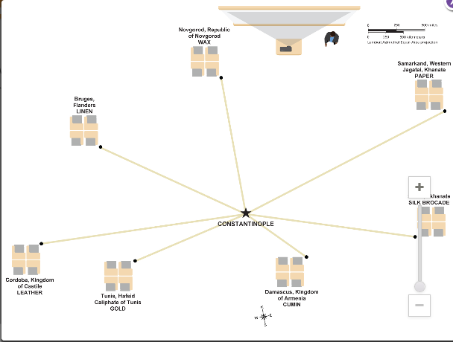

Slide 4
Rules of the Trade
1.Traders walk single file beside their path to enter the trading hub and single file on the other side to return home. They may not travel to other towns.
2.Trading is restricted to the trading hub and must be one token for one token. Trades can only be made with people from other towns.
3.Traders may carry only one token at a time.
4.When a trade is complete, traders take their merchandise home and pick up another token to trade.
5.Continue trading until at least one group has accumulated all seven products.

Slide 5
Debrief
Respond to the questions on your debrief paper.

Slide 6
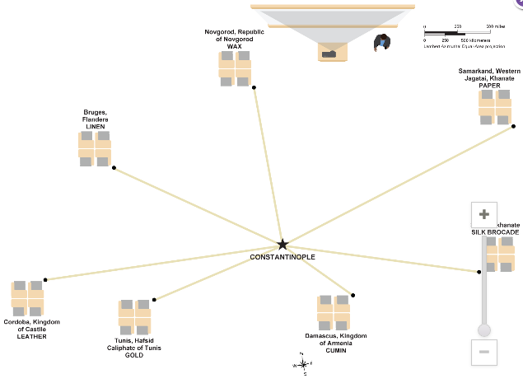
What do the lines represent?
Do you think they are realistic routes? Explain.

Slide 7
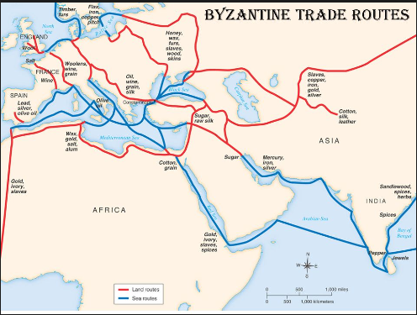
Based on this map and your experiences from class yesterday, what makes Constantinople an ideal place for trade?

Slide 8
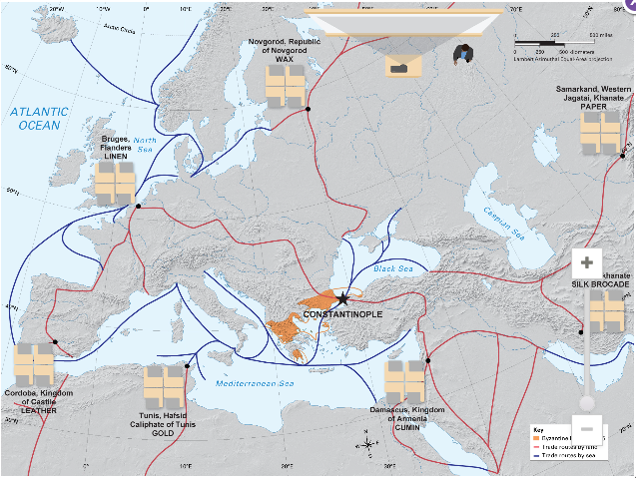

Slide 9
Objective
Historians will be able to describe what life was like in Constantinople through an image analysis, reading, and postcard activity.

Slide 10
Directions
For each image please discuss and share out with your group answers to the questions I ask.
Record your responses on the either side of the image on your worksheet.
Be prepared to share out with the class

Slide 11
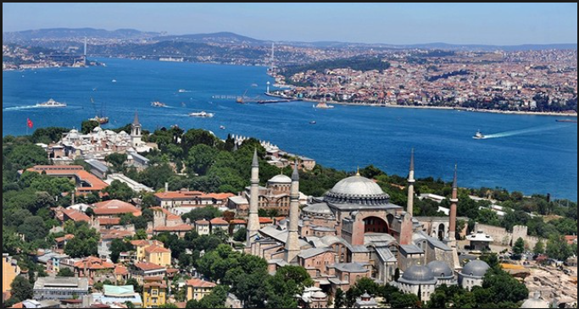

Slide 12
What do you notice about the location of this city?
Describe the buildings that stand out in the picture.
Do you think the domed buildings are modern or historic?
What do you think they are used for?
Why might this city be considered a strategic locale for a city?
How could you protect the city from invaders?

Slide 13
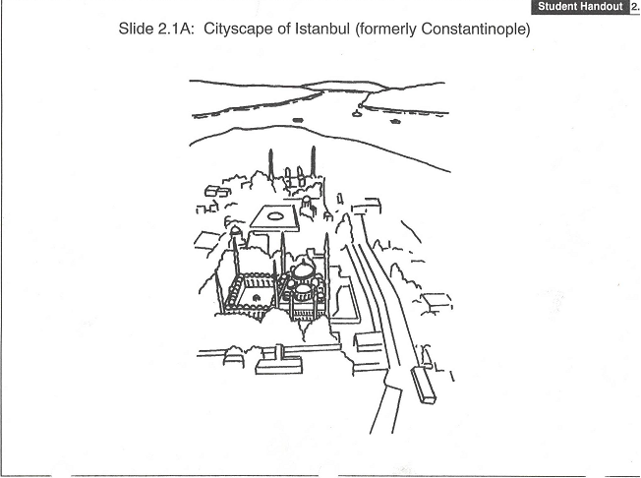
Peninsula – a piece of land surrounded on three sides by water.
Great for trade and defense. Was a shipping and trading hub.
Protected by 13 miles of walls, watchtowers and gates.
Walls only needed to be built on one side of the city.
Survived centuries of riots, religious discord, wars, and 88 emperors.
Preserved ancient Greek and Roman literature, philosophy, and culture.
Seized by Turks in 1453 and renamed Istanbul. Today is a major city in modern Turkey.
Capital of the Byzantine Empire. Heavily influenced by Roman Culture.
Built on seven hills like Rome.

Slide 14
Read page 64 in History Alive and answer the questions.
What made Constantinople easy to defend?
  Surrounded on three sides by water
  The harbor had a giant chain that kept out enemy ships
  Over 13 miles of some of the largest walls and fortifications on Earth at the time
What made Constantinople so wealthy?
  Was at a crossroads of Europe and Asia and many trade routes on land and water.
At its height….
  Had over one million people
  Greek was the official language, but many languages were spoken
  Ships crowded the harbors, many caravans on the streets

Slide 15
What did Constantinople have that many other European cities did not?
  Had a sewer system
  Services provided by hospitals, elderly homes, and orphanages
Most people were poor. The emperor would give out bread to help them, in exchange the poor would work on cleaning sewers and weeding gardens
Residents really enjoyed chariot races….they would form rival groups who would often fight and kill or hurt one another.

Slide 16
Postcard
Suppose that you are a trader visiting Constantinople for the first time.
On the left side of the postcard below, write a few sentences to a friend back home describing what you see as you walk through the city’s streets.
Include at least three characteristics about Constantinople and what life was like there.
On the right side, address your postcard to a friend in a faraway land selected from the map found on page 64 in History Alive.
On the front of the postcard draw an illustration showing what life was like in Constantinople.

Slide 17
Objective
Historians will be able to describe the importance of Justinian and Theodora to the Byzantine Empire through an image analysis, reading and response, and exit ticket.

Slide 18
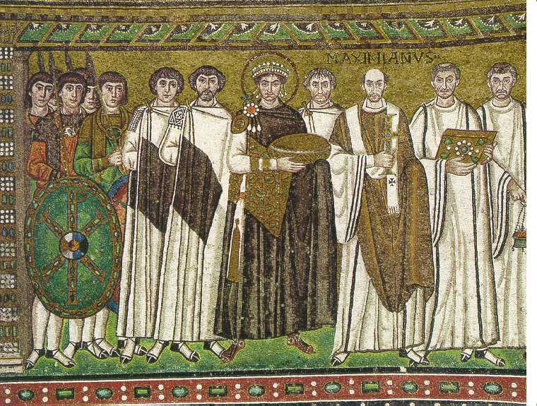
What do you see in the image?
Who stands out in this image? Why?
Justinian a famous ruler is located in the center. Who do you think are the people on either side of him?
What does this image convey about Justinian?

Slide 19
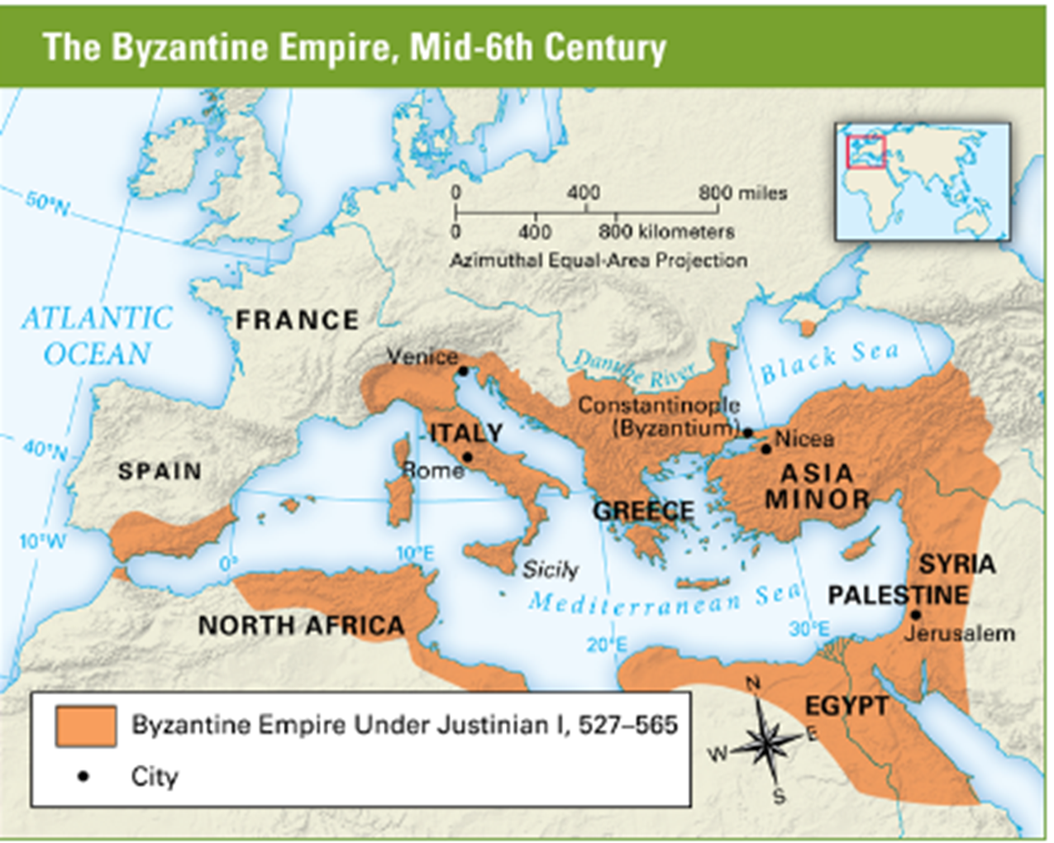

Slide 20
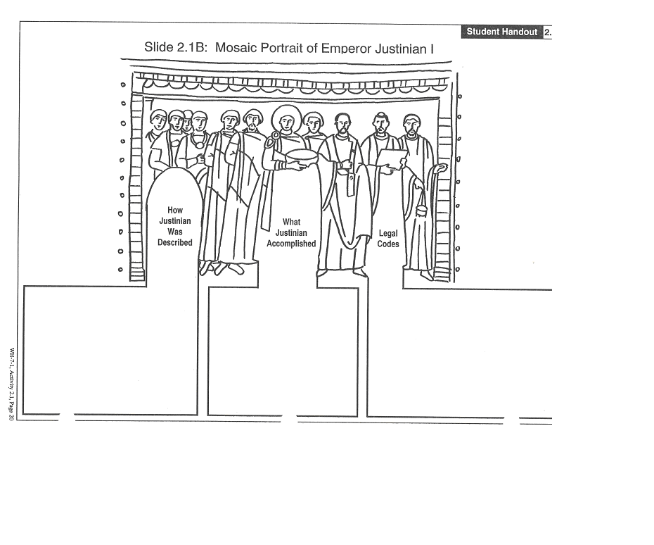
Came to the throne at age 45: considered Byzantium's most ambitious ruler.
Acted as head of church and state
Drove barbarians out of North Africa, Spain & Italy
Expanded the empire but failed to recapture Rome
Built bridges, churches, hospitals, libraries & parks
While alive Justinian was described as devout, determined, and energetic.
After his death, described as two faced and cruel.
Justinian’s scholars revised laws and created “The Justinian Code”
This law code influenced many modern law codes.

Slide 21
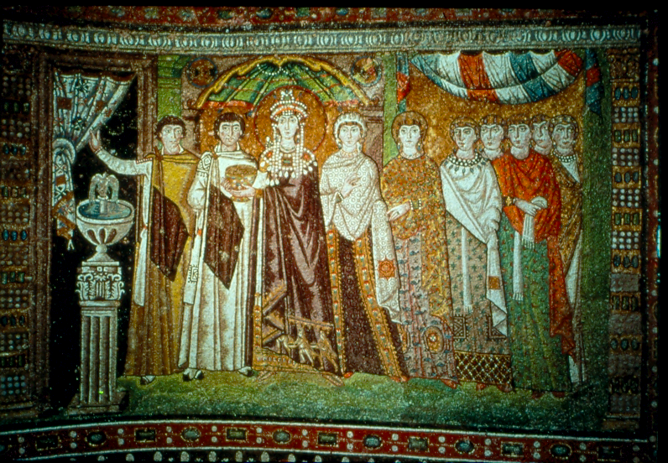

Slide 22
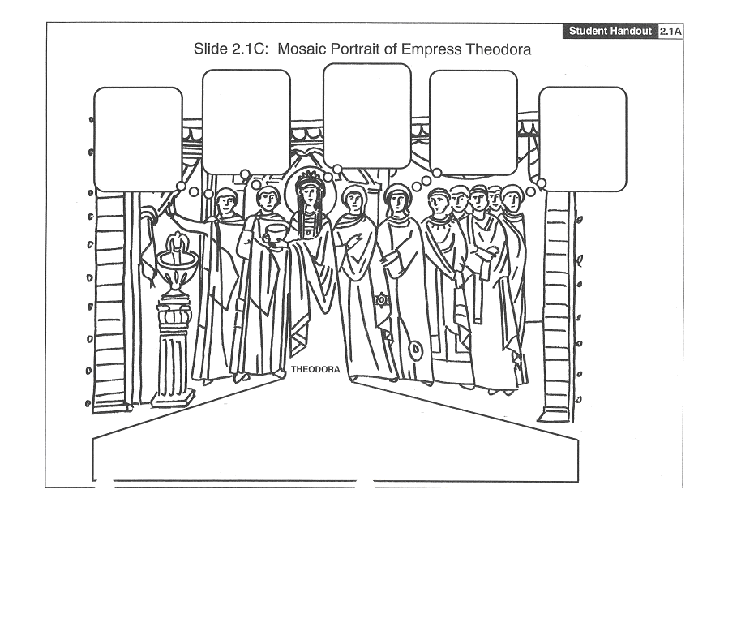
Destroys her enemies
Told Justinian he should not flee, but stay and crush the Nika Rebellion
Helped all women by convincing Justinian to expand women's rights
Sometimes angers Justinian by giving orders that cancel his.
The poor and homeless should thank Theodora because she started programs to help them
*Born into lower class as daughter of a bear keeper *Loved to travel, worked as an actress and dancer *Married Justinian in her 20’s and settled down *Equaled and sometime surpassed Justinian in political skill and wisdom

Slide 23
Justinian’s Code
Historians will be able to compare Justinian’s Code with California laws through a reading and comparison activity.

Slide 24
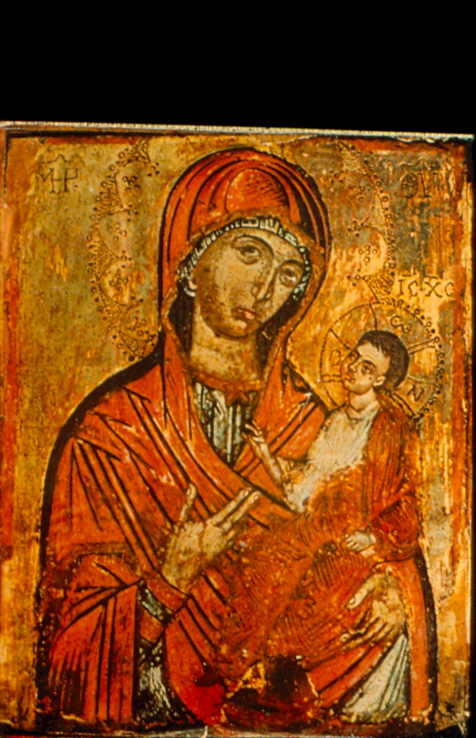

Slide 25
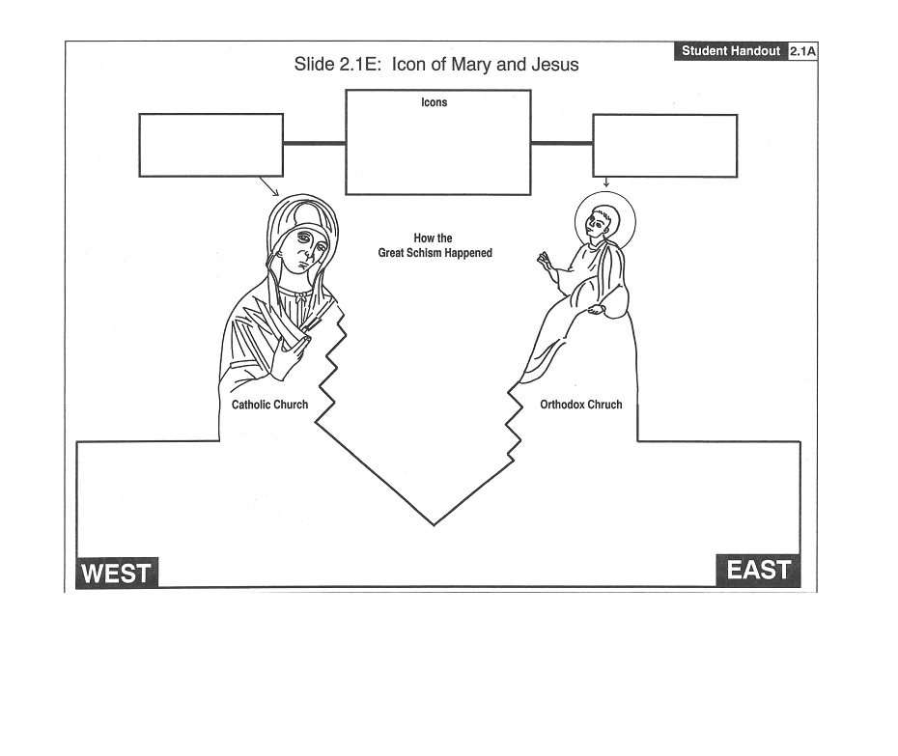
Icons – pictures of important Christians or events. They take the form of murals, wooden panels or mosaics.
In the west, icons were respected
In the east, icons were used, but many disapproved of them
The Schism of 1054
1. Christians in the Holy (Western) Roman Empire used icons because few people could read. 2. Some people in the Byzantine Empire disapproved of showing devotion to icons. 3. The controversy continued for years. It was one of many conflicts between the Church in the east and in the west. 4. In 1054, the Christian Church split into two churches forever
Orthodox Church *Orthodox is Greek for “Correct Belief” *Masses conducted in Greek; Bible translated into various languages *Patriarch appointed by the Byzantine Emperor *Bishops don’t marry, but priests can
EAST
Catholic Church *Catholic is Latin for “Universal” *Masses conducted in Latin *Pope is the supreme religious leader *Clergy does not marry
WEST

Slide 26
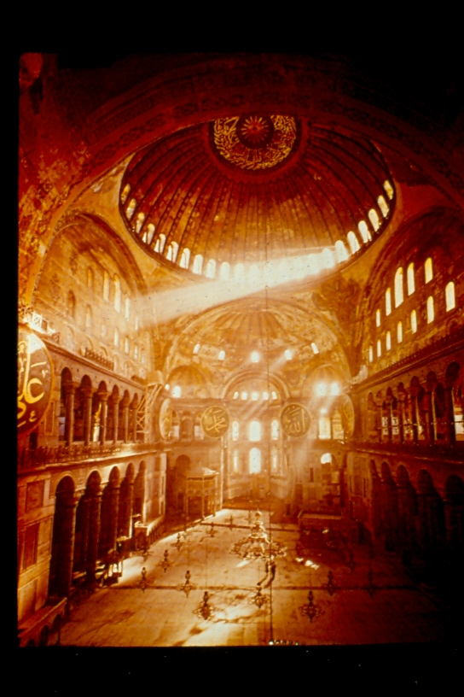

Slide 27
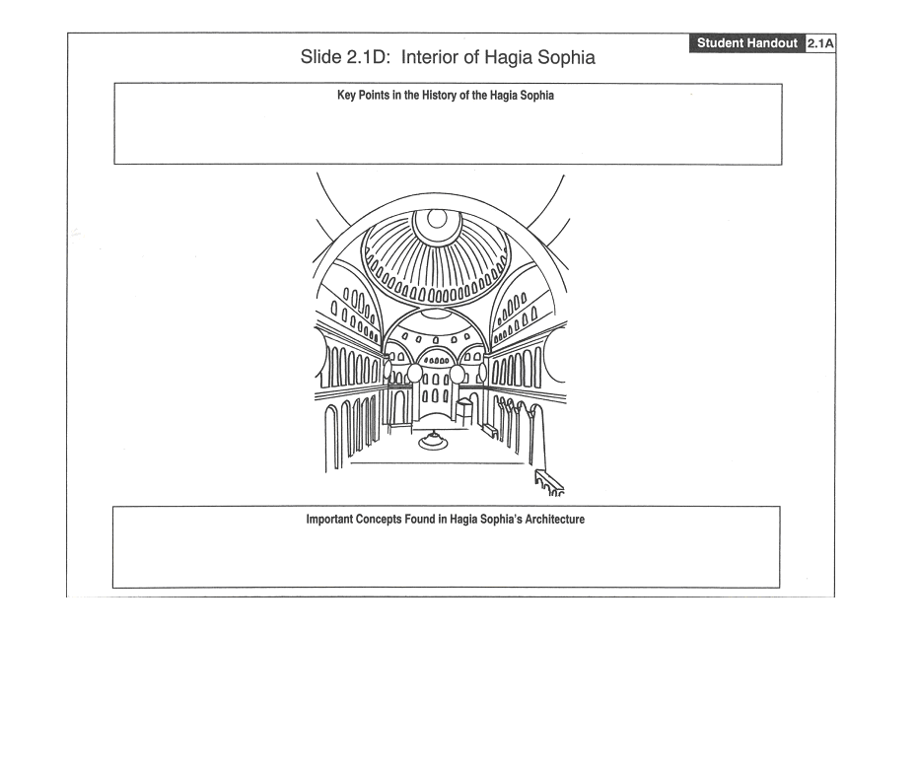
*built during the reign of Justinian *Largest of Justinian’s 25 new churches *built in 5 years *Also known as the Church of Holy Wisdom *became a mosque when Constantinople fell to the Turks *Today is a museum
*height – 180 feet *diameter – 107 feet *dome contains 40 stained glass windows at it’s circumference.
*Pendentive – used to join the walls with the base of the dome.
*Mosaics – pictures made of pieces of colored glass or stone inlaid in plaster. These glittered in the daytime.
*Six colors of marble were used to build the walls, arches and columns.
*plain exterior symbolizes earthly life *ornate interior symbolizes heaven *size, thick pillars and open spaces show Roman influence *intricate and ornate design shows Eastern (Asian) influences

Slide 28
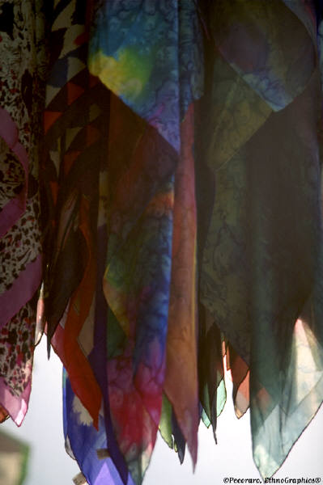
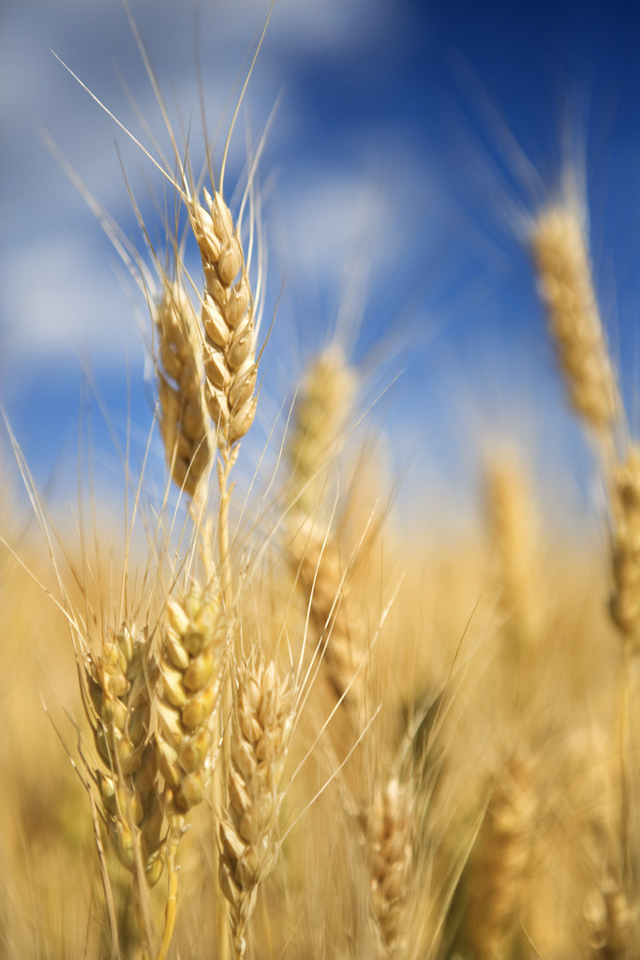
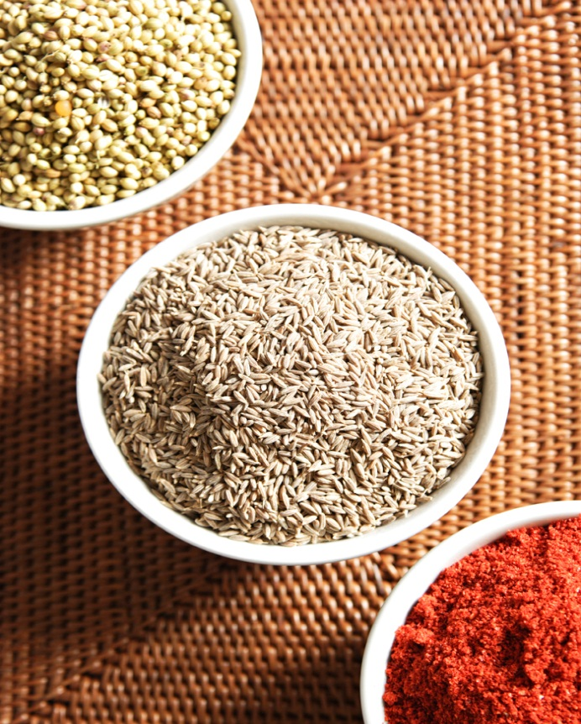
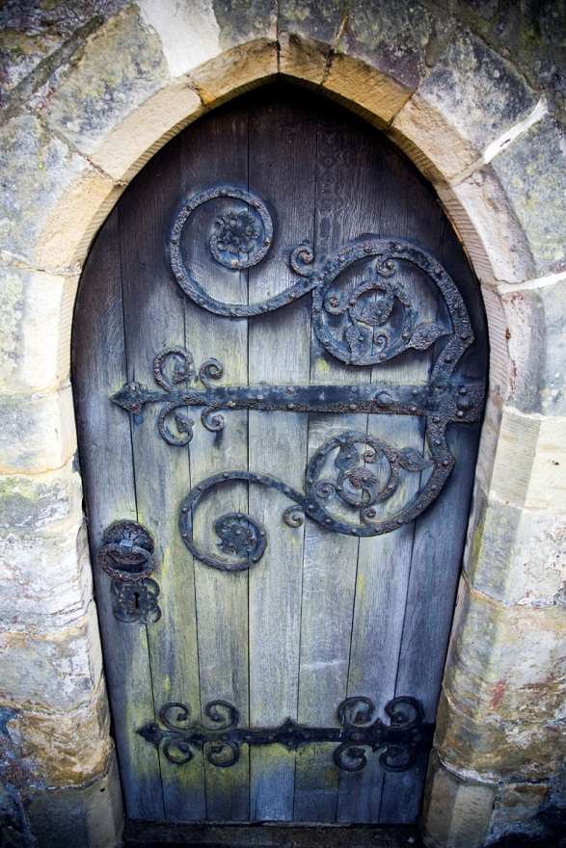
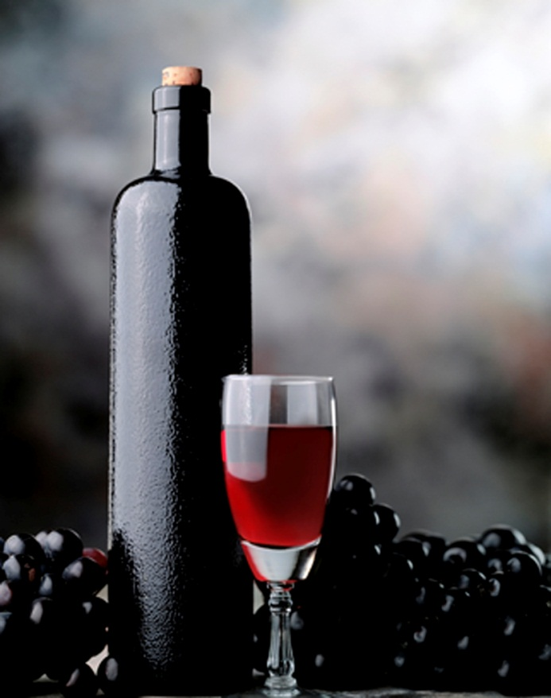
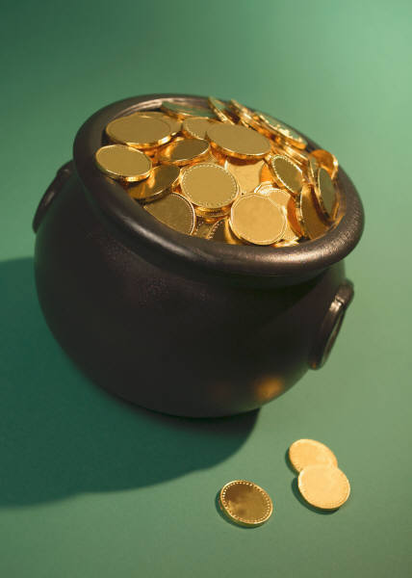

Slide 29
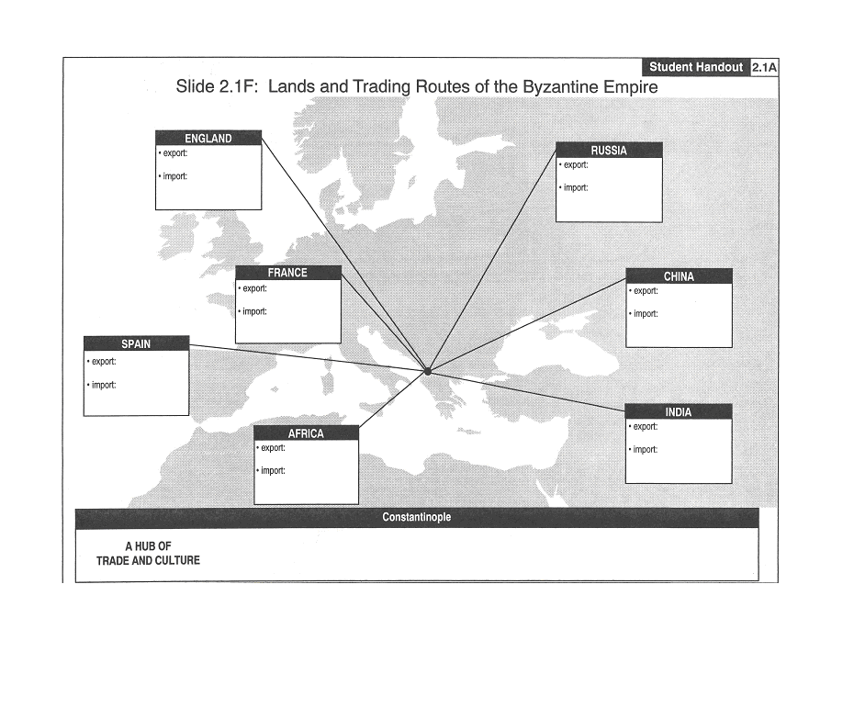
Import – an item brought into an area Export – an item sent to another area
England *Export – iron and tin *Import – works of the ancient Greeks
Russia *Export – honey, wood and furs *Import – art and architecture
France *Export – fine wines and wool *Import – silk (stole process)
China *Export – silk *Import - Christianity
Spain *Export – cork & grain *Import – Bronze church doors
India *Export – spices and jewels *Import - ivory
Africa *Export – ivory and gold *Import – Silk (stole the process from China)
*known as “The City”, home to the wealthy and powerful *connected to three continents (Asia, Africa, and Europe)

