Slide 1
Test Reflection: After receiving your Middle East Unit test complete your test reflection paper.

Slide 2
Have out your map of Europe and prepare to discuss your three questions.
What makes Europe similar to and different from the Middle East?

Slide 3
How has Europe changed politically since 1300?

Slide 4
Why do you think there are so many small countries in Europe?

Slide 5
Early Middle Ages (The Dark Ages)

Slide 6
Warm up:
Think back to the beginning of the Byzantine Unit….
Recall what happened to the Roman Empire?
What became of Europe after Rome?
Objective: Historians will be to describe and evalutate what life was like for people after the fall of the Roman Empire through a class discussion, reading and response, and exit ticket.

Slide 7
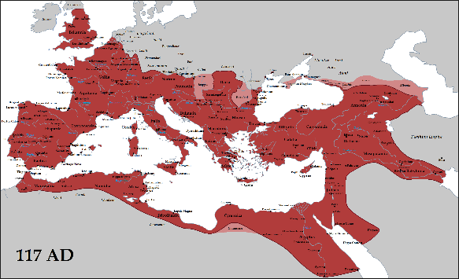
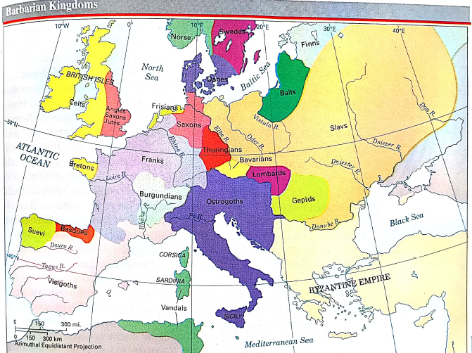
Warm Up: Aim- How was Western Europe organized after the fall of the Roman Empire?
Examine the two maps and describe what you see happening.

Slide 8
What comes to mind when you hear the term “Dark Age”?

Slide 9
What does the following quote tell us about life in Europe after the fall of the Roman Empire?
See how swiftly death comes upon the world, and how many people the violence of war has stricken. Some lay as food for dogs; others were killed by the flames that licked their homes. In the villages and country houses, in the fields and in the countryside, on every road-death, sorrow, slaughter, fires, and lamentations.

Slide 10
 | Merchants faced invasions on land and sea. Businesses collapsed and money became scarce.
 | European cities declined as centers of trade
 | People retreated to rural areas (countryside). Roman cities were left without strong leaders.
 | Literacy rates plummeted. Few people except priests and other Church officials were able to read. Most Greco-Roman learning was forgotten.
 | As German-speaking people mixed with the Roman population, Latin began to change into the languages we know today such as French, Spanish, and Italian. Latin was no longer a unifying force within Europe.
Decline of Learning Downfall of Cities Loss of a Common Language
Disruption of Trade Population Shifts

Slide 11
Exit Ticket
Complete the three questions on the exit ticket, when you are finished turn it in to your class bin.
Retrieve Charlemagne packet
Have out D4 and Clock buddy paper

Slide 12
Warm Up
What was life for people after the fall of the Roman Empire?

Slide 13
The Early Middle Ages/Dark Ages: 500-1000
Barbarian Invasions and Fall of Roman Empire
Germanic Kingdoms and Charlemagne
Disunity and Invasion
Rise of Feudalism

Slide 14
Retrieve a copy of Across the Centuries and open to pages 256-258
Answer the questions
1. What do historians call the time period between the fall of the Roman Empire and 1450?
2. Why do historians call the early part of the Middle Ages 500-1000 “The Dark Ages”?
3. The Eastern half of the Roman Empire continued on as the Byzantine Empire, as we studied earlier this year. The Western half was taken over by several Germanic (barbarian) tribes. Which group of these barbarians took over the area that is today France and Germany?
4. What are two of Clovis’ accomplishments?
5. Why was it important for Clovis to convert to Christianity?
6. In what other ways were Roman traditions preserved during this period of time?
7. What made Charles “the Hammer” Martel’s victory at the battle of Poitiers significant in European history?
8. Why did Pope Zacharius agree to recognize Pepin as the King?

Slide 15
1. the Middle Ages last from 500-1450
2. Because there is not much information (no reading, writing etc) so we as historians are in the dark as to what is going on. Also, it symbolizes the general sense of doom and gloom that people had back then.
3. The Franks took over the area of France and Germany

Slide 16
4. Clovis: a. he expanded the boundaries of the Frankish kingdom, making them one of the more powerful kingdoms in Europe
B. Converted his people to Christianity
5. The Church wanted to serve Christians in that part of Europe. Also the church of Rome was one of the few stabilizing forces after the fall of the Roman Empire. It was something that Europeans could share.
6. Latin continued to be used, Laws that kings set up were based on Roman laws, Roman roads and trade routes were still used.
Monasteries kept Roman and Greek literature ensuring that those culture’s ideas would stay alive

Slide 17
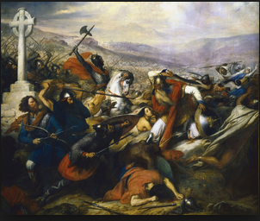
7. The Frankish victory at Poitiers by Charles Martel ensured that Europe would continue to be a Christian culture.
8. The other kings were not very effective. Also by giving their blessing the Pope had some power over the king.

Slide 18
Are there any ways that Clovis’ leadership decisions were similar to what you stated you would do if you were king back then?
Different? If so then do you agree with what Clovis did?
Were these good decisions?
Is it important that Roman traditions survived during this period of time?

Slide 19
Charlemagne
Objective: Historians will be able to describe and evaluate the reign of Charlemagne through a station reading, class discussion, and caricature assignment.
Warm-Up: Think and Share to your Group:
What actions or characteristics make an effective leader?

Slide 20
Charlemagne (Charles the Great): Overview
Father and Grandfather were the prime ministers to the Frankish kings, but held the real decision making power.
His grandfather was Charles Martel who repelled a Muslim army from southern France, so he had a good ancestry.
When his father died, Charles and his brother Carloman divided their realm.
When his brother died, Charles became the ruler of all of the Frankish lands.
So in 768 Charles the Great or Charlemagne was the most powerful leader in Europe other than the Byzantine emperor.
We will now examine his reign to determine what he did and how effective of a leader he was.
You will rotate around the room to different stations where you will read the article, answer the questions

Slide 21
We will now examine his reign to determine what he did and how effective of a leader he was.
You will rotate around the room to different stations where you will
read the article
answer the questions for that article
Rate how effective of a leader Charlemagne was in that aspect of his reign
Check in with Mr. Plott after each station.

Slide 23
Warm Up
Get out a loose leaf paper- then tear it in half and share it with the person across from you.
ON your paper write down four statements about Charlemagne.
One of those statements must be false
Then swap your papers with your partner and determine which statement is false.

Slide 24
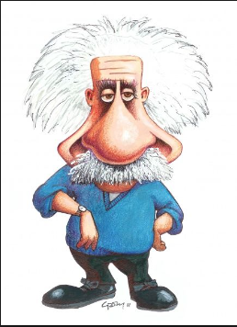
Charlemagne Caricature
What is a caricature?
a picture, description, or imitation of a person in which certain striking characteristics are exaggerated in order to create a comic or grotesque effect.

Slide 25
Charlemagne Caricature
Today you will be creating a caricature of Charlemagne that illustrates Charlemagne’s leadership qualities and achievements. Your caricature must include the following items:
A central figure (Charlemagne) – 1 point
Five characteristics/accomplishments of Charlemagne. Use your notes from class. 5 points
Captions explaining each trait shown (A good complete sentence or two!)- 5 points
Be neat and colorful. Points for this are included in the other requirements of this assignment.
A well-thought out response to the following prompt:
Based on what you have learned in class, Does Charlemagne deserve the title “the Great?”
Your response should include a claim and at least 2 specific and well-explained facts from our classroom learning.
A justification as to why those facts prove he deserves the title or not.
4 points

Slide 26
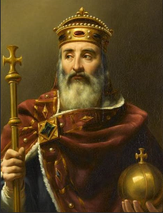
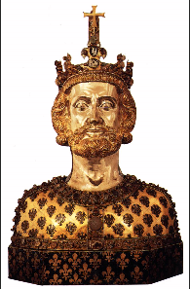

Slide 27
Exit Ticket

Slide 28
Military Leadership
Fought 50 campaigns in 46 years of rule.
Wanted to unite Western Europe
Had a large, powerful army that could defeat any opponent
By the end of his reign he ruled most of Western Europe
Wanted to convert people to Christianity
After defeating pagan groups he would force them to convert
When some Saxons rebelled, he had 4,500 leaders beheaded in the “Bloody Verdict of Verden”

Slide 29
Cultural Leadership
Sought to bring back culture and learning that had fallen away since the fall of Rome
He built new schools to educate upper class children to prepare them for government and church jobs. There were also schools for lower-class children
Had Christian and ancient books copied and preserved
He even learned how to read and write, which was rare for rulers at the time
Built many churches

Slide 30
Religious Leadership/Relationship to the Church
He took religion very seriously….he made reforms so that priests actually knew how to do their job. Priests had to act like holy men, before this priests could act however they wanted.
He protected the Pope from enemies and the Pope crowned him Holy Roman Emperor, which upset the Byzantines who saw themselves as Romans.

Slide 31
Government Leadership
Charlemagne believed he was chosen by God to rule.
He had absolute authority over his kingdom and was the center of government
He created close relationships with the Church because they had experience managing people
He would appoint counts to manage 350 counties in his empire. They were hired and fired at his leisure. Their responsibilities were…
Maintain a small army to protect his kingdom
Collect taxes
Settle disputes among the commoners
They also had to enforce any laws that Charlemagne created
To keep control Charlemagne would have musicians travel the country singing about his greatness, and had spies report back whatever people (commoner and noble) were doing

Slide 32
Treatment of Non-Christians
Towards pagans he would offer them the choice of either converting to Christianity or being executed. He was successful using this strategy but it still took him over 30 years of fighting in Germany.
Towards Jews he was much more tolerant.
He allowed them to worship their religion
They could travel freely to Muslim lands
Started businesses in trade, banking, craftsmanship (making objects)

Slide 33
After Charlemagne
His empire was always under threat from outsiders.
Muslims from Africa
Vikings from Scandinavia
Magyars from Central Europe
However Charlemagne’s descendants would typically fight and compete against one another, so national defenses would not be a priority. This allowed invaders to attack towns and cities, which further destabilized the government.
Local leaders would take more control, which would become the system of feudalism.

