Slide 1
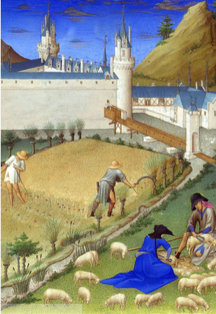
Feudalism in Europe

Slide 2
Warm Up
Write your own definition of what loyalty is.
Was there ever a situation you know of where loyalty was important in the outcome?

Slide 3
Objective: Historians will be able to identify, describe, and evaluate the system of feudalism through a class simulation, reading and response, and rating activities.
Loyalty can be important today among friends and family, in business, and in politics.
After the fall of the Roman Empire, promises of loyalty became a critical element of western European society.
Western Europeans built a social structure based on loyal relationships and the exchange of valuable goods and services. By doing so, they hoped to gain political order, protection from outside threats, and a stable form of leadership.

Slide 4
Open your History Alive Textbook to page 20 and answer the questions on the front of your worksheet.
What benefits did people gain from the system of feudalism?
What roles did each person have:
King
Lords
Knights
Peasants/Serfs
What is a manor? Why were they self-sufficient? (What does that mean?
How did you decide which group to be a part of?

Slide 5
Video
Any new or interesting facts about the roles of feudalism?
How were the lives of upper class women different from women in lower classes?

Slide 6
Key Questions
What is feudalism?
What levels made up feudalism? And what was each responsible to do?
How well did feudalism establish order in Europe in the Middle Ages?

Slide 7
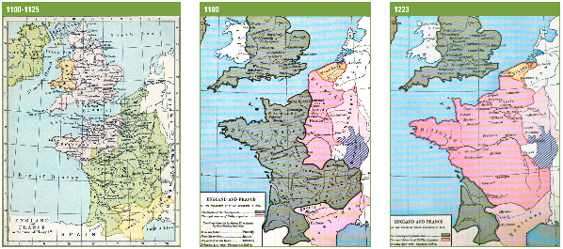
Let's use these three maps to help us answer the question, "How well did feudalism establish order in Western Europe in the Middle Ages?“
As you look at the three maps, identify the similarities and differences between and among them.

Slide 8
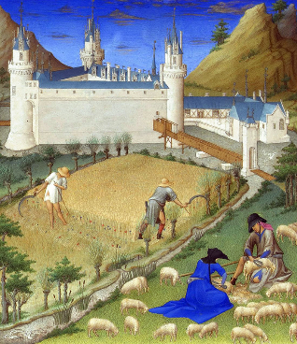
For this activity, you will be a member of European society during the 11th century.
In this society, people were born into different classes, although some of the roles that people took on came about as the result of oaths of loyalty rather than social standing.
Read your role card and spend a moment thinking about your role in medieval society.
Each peasant should also have 10 food tokens.

Slide 9
Your classroom has been set up to resemble a feudal domain with a castle and four manors.
You are going to experience European feudalism and life on a manor. The steps on the next few slides will show you how. As each step is revealed, read the directions and the lines you should speak, then carry out the actions.

Slide 10
Step 1: Ruler assumes the throne in his or her castle.
Ruler: Walk in a stately manner and sit on the throne. Enjoy the items that have been provided by your loyal subjects.
All others (Standing around room): Applaud respectfully as the ruler approaches his or her throne.

Slide 11
Step 2: Peasants, go to your designated manors.
Ruler: Watch quietly.
Lords: Wait quietly outside the castle
Knights: Bring your “horse” (chair) from a stable by moving a chair to just beside you next to the castle.
Peasants: Go to your manor. Sit on the floor in a field outside the manor house. Begin producing food by neatly coloring the grain on each food token.

Slide 12
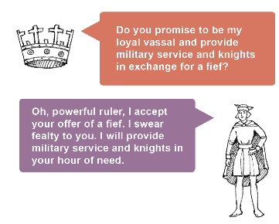
Step 3: Lords and ruler negotiate the oath of loyalty (fealty)
Knights: Watch quietly while you groom your horse
Peasants: Watch quietly while you continue to produce food for your manor.
Lords: Kneel before the ruler, holding out your hand. Speak your oath after the ruler speaks to you.
Ruler: One by one, take each lord’s hand and speak your line. After the lord speaks the oath, give him or her a fief token.

Slide 13
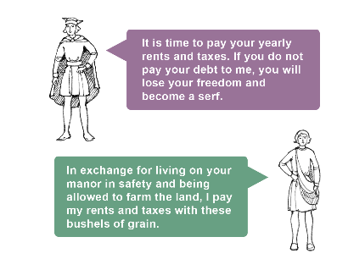
Step 4: Lords go to their manors and collect payment from peasants.
Knights: Watch quietly while you polish your "shield."
Ruler: Watch quietly while you enjoy the items provided for you.
Lords: Sit at a desk in your manor house. Demand payment from each peasant by speaking your line, and collect food tokens from each peasant.
Peasants: Listen to your lord and respond with your line. Then give your lord three of your completed food tokens and continue to color the rest.

Slide 14
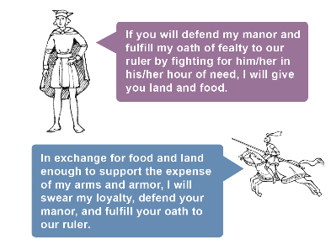
Step 5: Knights seek land and food by offering military service and loyalty to lords.
Ruler and Peasants: Watch quietly while you continue your activities.
Lords: Recruit at least two knights to defend your manor and fulfill your obligation to your ruler:
•You may offer a knight as many food tokens as you wish but must keep some for yourself.
•Have knights with whom you have reached an agreement kneel while you speak your line. After their oaths, give them their food tokens.
Knights: Approach lords to find out what they offer to pay in exchange for military service. When you have reached an agreement: kneel, listen to the lord's promise, say your oath, and collect payment.

Slide 15
Reflection
•How did it feel to be a ruler? A lord? A knight? A peasant?
•In what ways were the ruler, lords, knights, and peasants interdependent?
•Do you think loyalty oaths were necessary?
•What do you think would happen if someone violated a loyalty oath?
•What are the benefits of this type of society? The challenges or drawbacks?
What factors could possibly destroy the security of this society?

Slide 16
How does historical reality and our class room experience compare/contrast?

Slide 17
Feudalism in Europe

Slide 18
Social Roles in Feudalism
Over the next several lessons we will be looking in more depth at what life was like for the different social levels in feudalism.
At the end of this we will be comparing how life is similar and different between these social groups,
And how well of a job feudalism did at providing
  Security
  Economic Stability
  Prosperity
  Opportunity
For Europeans

Slide 19
The Monarchy and Nobility
Historians will be able to describe what life was like for the upper classes in feudalism through a reading and response and video.
What were the responsibilities of the king and his nobles?
What were their daily lives like?

Slide 20
Monarchy
Why could kings rule?
  They claimed they received their power to rule from God alone
Were kings as powerful as many people think they were?
  No, they were dependent on lords for troops. Lords could ignore or disobey kings if they really wanted
  They would need to give land and important responsibilities to lords in order to keep them loyal….hopefully
Who was William the Conqueror?
  A lord from Normandy (France) who conquered England and became king
  Implemented feudalism on his new realm

Slide 21
Nobility- Historians will be able to describe the role and daily lives of nobles through a reading and video activity.
Using your History Alive textbook (page 22-23) and the video The Middle Ages: The Noble, answer the questions on your worksheet.
Describe what a manor was like.
  Was a large house or castle surrounded by lands that were farmed by peasants or serfs
  Castles had strong defenses like walls, moats, murderholes, etc; manors though were much more comfortable like houses today are…so nobles gradually switched to living in manors instead of castles
  Castles showed off the power of the noble, and was a visible symbol to lower classes of who was in charge
Responsibilities of lords?
  TO manage and defend his lands and the people who worked it
  To support the king in times of war, or with advice and services during times of peace
  Act as a judge in settling disputes
Role of noblewomen?
  Had little choice in who to marry
  But acted as a business partner with her husband to manage the manor whenever he was gone
  They also helped raise their children, manage the servants, and get the house in order for important guests

Slide 22
According to the video, how did the nobility show that they were wealthy and powerful?
  Had expensive clothes (made of silk)
  Only they could wear the colors red and green
  Went hunting and played games
  Had large banquets with many types of meats and dishes; spices (which were very expensive) were used…spices really showed off wealth
How was their lifestyle different from the modern day?
How were serfs and nobles dependent on each other?

Slide 23
Exit Ticket
In one word or phrase how would you describe the lifestyles of lords.
Explain why you chose that word or phrase
Are there any people in today’s society that have responsibilities that are similar to that of the Noble/Lord in Medieval Europe?

Slide 24
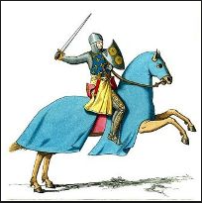
Knights
Historians will be able to describe the role and lifestyle of knights through a reading, and herald activity.
Retrieve a History Alive textbook (pages 24-25) and answer the questions

Slide 25
Life of Knights
Why would a knight have to be wealthy?
  Armor, weapons, training, and horses are expensive to have and maintain
Page- typically 7 years old, would learn how to serve other nobles, learned dance, music, reading, manners
Squire- travelled with a knight and maintained the equipment and horse, would receive training from the knight
Knight- if deserving, they would go through a complex religious ritual. Sometimes a squire could be promoted if they fought bravely in a battle
How did chivalry influence knights?
  It was a code of conduct: they were supposed to be loyal to the Church and their lord, be just and fair, act bravely, protect the helpless and women
Purpose of jousts and tournaments?
  To show of their skills, train, and receive fame and money rewards
What made them obsolete?
  The creation of firearms and cannons; they moved too slow and were outdistanced by firearms

Slide 26
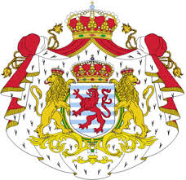
Heraldry

Slide 27
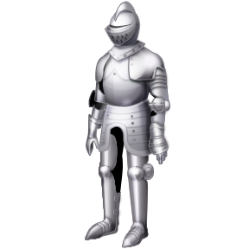
Why might a knight dressed like this have difficulty in battle?
In the early 12th century, helmets and armor began making it difficult to tell armed knights apart.
The solution was for each knight to paint something personal on their shield.
These designs were important in battle, but they also functioned like team uniforms when knights met in tournaments.

Slide 28
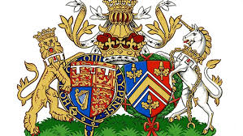
Overtime, shield emblem designs became enduring symbols of their owners, and of their owners families.
It became quite fashionable to have a “coat of arms”, so people began hiring artists to design them.
Prince William and Kate Middleton’s Coat of Arms
Notes:
Prince William and Kate Middleton’s Coat of Arms

Slide 29

Does this look familiar?
Red and White: Represent the Crossland Family
Black and Gold: Represent the Calvert Family
!

Slide 30

Are these symbols still used today?
What symbolic devices are part of this shield?

Slide 31
Now It’s Your Turn!
Today we will begin a project in which you will create your own Personal Coat of Arms!
It will include:
Your cadency or birth order
A main color on your shield
Three charges
A motto
Write a paragraph explaining your coat of arms and why these traits are important for a knight.

Slide 32
Ideas…
Bear: protectiveness
Bee: Industrious
Camel: Don’t give up
Dog: Loyalty
Dragon: Defender
Unicorn: Extreme Courage
Wolf: Constant Vigilance
Snake: Ambition
Crescent: victory over adversity (horns are always pointed up)
Eagle:
Heart: sincere
Oyster Shell: Traveler
Axe: Dutiful
Fire: Enthusiastic
Sun: Glory
Lightening: Makes decisions easily
Moon: Calm
Crosses: Christian

Slide 33
Colors:
Yellow or Gold: Generosity
White or Silver: Peace and Sincerity
Black: Constancy and Grief
Blue: Loyalty and Truthfulness
Red: Military Fortitude
Green: Hope, Joy, and Loyalty
Purple: Sovereignty and Justice

Slide 34
Warm Up
Why were castles so popular in the Middle Ages?
What are some of the defenses used by castles?
What eventually led to their, and knights, demise?
What is a peasant/serf? What do you already know?

Slide 35
Peasants
Historians will be able to describe the roles and daily life of medieval peasants through a reading response and video activity.
Read pages 26-27 and answer the questions about peasants.
What were the roles of peasants in feudalism?
  They were the farmers and produced food which allowed other groups to lead, fight, or create crafts
Differences between free and unfree peasants?
  Free peasants had to pay rent, but could move around as they pleased
  Unfree peasants/serfs were required to stay on their manor, they needed permission to leave
What types of jobs did they have and responsibilities to their lords?
  Farmed most days
  Some could gain skills and jobs like blacksmiths, cobblers (shoemakers), carpenters, other skilled jobs
What was their daily life like?
  Lived in small, cramped, smoky houses
  Limited access to hygiene (bathing, brushing teeth, toilets) and balanced meals (mostly low quality bread and porridge, though some meat like pork was available)
  Several families shared houses/ even beds

Slide 36
Medieval Primary Sources
In the next slides and on your paper are images created in the late 1300s/early 1400s. These are called the Tres Riches Heures du Duc de Berry. With your groups describe what feudal groups are shown and what it shows about life in medieval Europe.

Slide 37
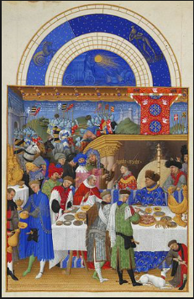

Slide 38
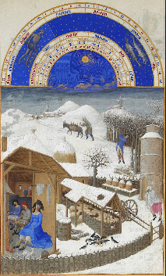

Slide 39
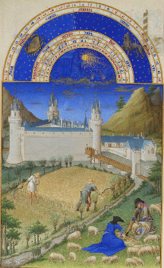

Slide 40
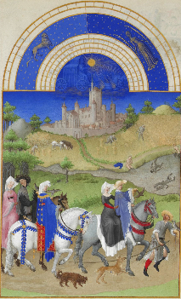

Slide 41
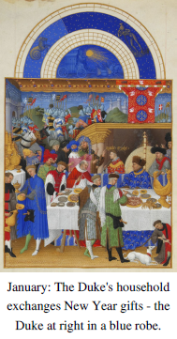
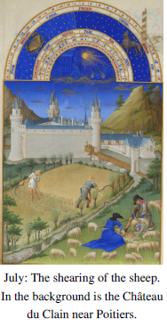
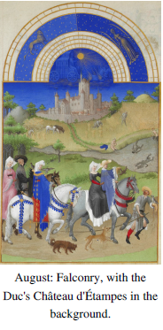
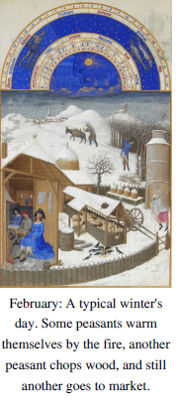
Medieval Primary Sources
Below are images created in the late 1300s/early 1400s. With your groups describe what feudal groups are shown and what it shows about life in medieval Europe.

Slide 42
Do you agree with the textbook that peasants held up the entire system of feudalism? Why or why not?
In a word or phrase, how would you describe the life of a peasant/serf? Explain why you selected that word/phrase. Draw an illustration.

Slide 43
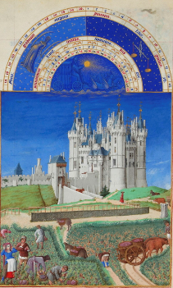
Which social classes can you see in this painting from the Middle Ages?

Slide 44
Feudalism Bingo
Place one vocabulary term from our learning of feudalism in each box on the bingo board.
Bingos are: straight lines up or down, or diagonal.
When you have a bingo, call out CHARLEMAGNE!

Slide 47
Step 6: Buildings are fortified to protect from an “attack.”
Lords: Send one of your knights to the ruler to fulfill your oath. Collect your “horse” from the “stable” and place it in the manor house.
Knights: Place your “horse” beside the horse of your lord or the throne of your ruler.
Rulers and Lords: Oversee the fortification.
Knights and Peasants: Work to fortify the manor house or castle you will defend. Fortifying means wrapping the string around the outside of your castle

Slide 48
Attack!!!!!
Ruler: Sit on your throne and watch your borrowed knights defend your castle.
Peasants: Sit behind the cavalry and shake your "farm implements" at the attacker.
Lords and Knights: Sit on your horses and work together to defend your castle by using your "shields" to prevent the balls of paper from striking anyone.
All: Speak your line when attacked.

Slide 49
Surprise attack!!!!
Usurper: Launch a surprise attack on Copshorn Manor!
THE ATTACK IS OVER!

