Slide 1
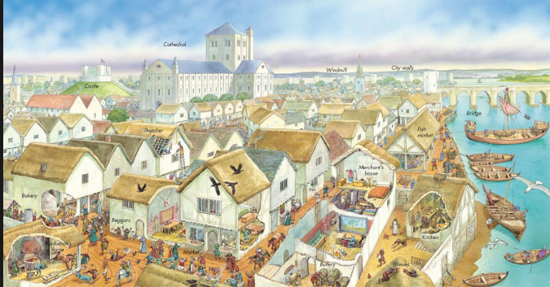
Medieval Towns

Slide 2
Objective Historians will be able to describe what life was like in a medieval town through a reading response, and gallery walk activity.

Slide 3
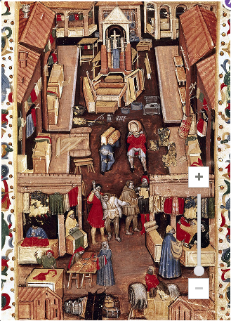
Preview Questions
Why would people come to the market place?
How are people here similar and different?
What is missing that you would expect to see in a market?
1) What interesting or important details do you see?
2) Study the elements shown in this image. What hypothesis can you form about why community members might come together in this part of town?
3) Look at the people who are present in the image. What similarities and differences do you notice?

Slide 4
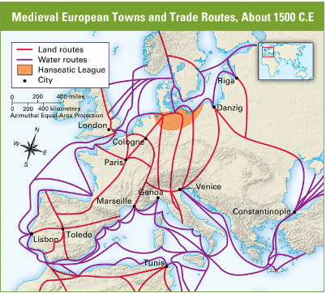
Preview Discussion
What does this map tell us about Medieval European society?
In one or two sentences describe what we have learned so far about European towns and trade.

Slide 5
Read Section 4.2 in History Alive and respond to the text questions.
After the fall of Rome towns and cities declined with most people living in the countryside in scattered villages. By the 1200s towns were growing again.
1) Where were towns in medieval Europe often located? Why?
Along rivers or the sea because they allowed for faster travel and communication
2) What contributed to the growth of towns in medieval Europe?
Improved agriculture- farmers had a surplus of crops which meant they had enough to feed themselves and extra left over to sell
Revival of sea trade- The Crusades reopened trade routes with Asia and the Middle East
3) How was a town able to become independent form a feudal lord?
Sometimes through violence and riots
Getting a royal charter which meant that towns could govern themselves separate from lords
Gradually power shifted from lords to merchants and craftspeople

Slide 6
Snowstorm
On a half sheet of paper write your name, and a 2-3 sentence summary of towns and trade in Medieval Europe.
Combine what you learned from your reading and questions, the map of European trade, and the marketplace artifact.

Slide 7
Gallery Walk
Today: You will research your topic, complete your section of your worksheet, and begin creating your poster
Refer to your direction paper
Tomorrow: Poster creation- You will have some time to create and finalize your poster, posters will be hung up by the end of this class period.
Monday: Gallery walk and class review
Tuesday: Merchant/Town video; Town journal assignment
Depending on progress- Towns and Trade quiz will occur middle of next week

Slide 8
Guilds
Medieval towns were places of trade; but also places where goods were produced
Guilds were an organization of people in the same craft or trade
Guilds oversaw individuals in a certain profession
They had a number of jobs such as merchant guilds (traders, merchants, bankers) and craft guilds (cloth makers, stonemasons, carpenters, cobblers, blacksmiths, glassmakers, etc)
They provided help to its members, who paid a due to support the guild.
Controlled the hours of work, the prices of goods, dealt with complaints, and punished corrupt members
Guilds also gave money to members in need such as illness, injury, or death in their family
To join a guild:
Become an apprentice around 12 who was fed and trained, but rarely paid (like paying to go to college or a trade school today)
After seven years the apprentice has to pass a series of tests to prove they have mastered their trade
Journeyman- craftspeople who found work day to day
Master- craftsperson who actually owned a business and hired others for jobs

Slide 9
Trade and Commerce People went to towns to trade, so when trade increased towns increased as well
Early Middle Ages (: most trade was in luxury goods that only the wealthy (kings, nobles, some knights) could afford.
Common people made their own necessities
High Middle Ages: Trade was more common, regular people were doing more buying and selling food, clothing, household items. Towns started becoming specialized in different products like silk, cloth, glass
Towns had a marketplace where business was conducted.
Merchant fairs happened a few times a year which attracted people from all over to trade
This increase in trade led to merchants becoming very wealthy; ran large businesses; merchant guilds controlled the business of towns
Jews were discriminated against where they could not own land, could have their property seized, attacked by Christians
Many became moneylenders or bankers because Christians were not allowed to loan money
Moneylending is an essential part of an economy, but Christians still looked down on Jews for doing that work

Slide 10
Homes and Households
Towns were small and crowded. Houses were typically small and narrow, in some cases they would bend due to old wood
Poor houses: small, several families shared a house, maybe only one room to eat, cook, slept; often times worked where they lived
Rich: Large, splendid homes; often worked on the first floor, other levels is where the family and servants lived with multiple rooms.
For rich and poor heat was always a concern and a danger, where the only light source was by fireplace or candle, heat was only fire. Windows were covered with parchment,
so houses were smoky, cold, and dim.
Nearly half of all children did not live to adulthood
Some attended school, rich children might learn an artform like painting or music
Boys generally learned their father’s job
Girls usually married young around 15; learned to sew, cook, chores, childraising

Slide 11
Disease and Medical Treatment
Medieval towns were absolutely filthy
People used the bathroom in outside shelters, in chamber pots which were emptied in streets or streams, or wherever
Trash was thrown in the streets
People lived in close, crowded conditions (easy for germs to move from person to person)
Bathed maybe once a week
Mice, Rats, fleas, lice infested people’s homes and clothes; lived in close quarters with livestock (cows, chickens, pigs, sheep, goats, horses)
Leprosy, measles, small pox, cholera, scarlet fever, and others
No idea how diseases were spread or came about; no knowledge of germs because they had no microscopes
Treatments consisted of separating people with leprosy into self-contained communities; Jews were also seen as causing these diseases which spurred on more discrimination
Hospitals were rare, treatment done in the home, which could lead diseases to sweep through families
Herbs and prayer were generally used; sometimes studying the planets and stars or magical spells
Often “bleeding” occurred where a cut was made to drain out blood, or leeches were used

Slide 12
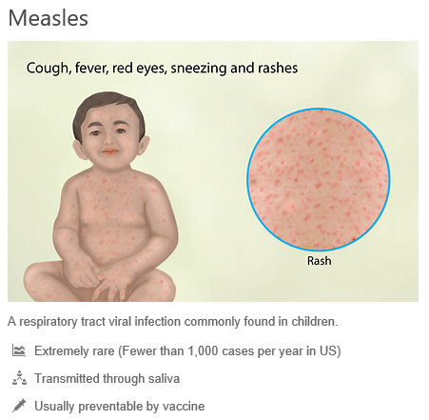
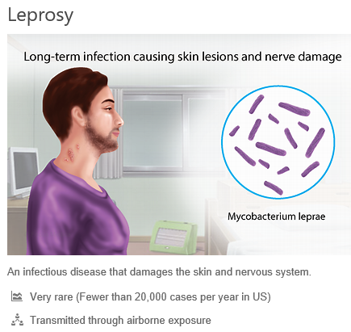
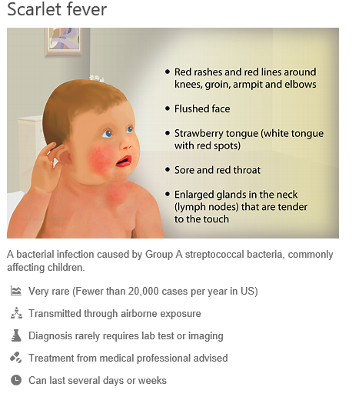
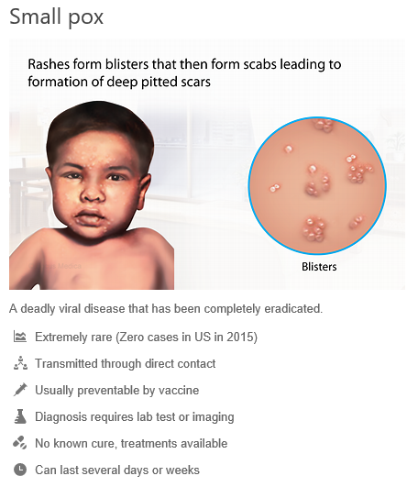

Slide 13
Crime and Punishment Towns were crowded, noisy, smelly, and dangerous
Pickpockets, thieves, highway robbers, livestock stealing, murder were common
Towns would employ night watchmen to patrol the dark streets
Determining guilt or innocence could be quite different from today
Trial by ordeal - a person has to go through a dangerous situation to prove their innocence, However sometimes survival is proof of their guilt
Trial by combat- accused has to fight to prove their innocence, people believed God would protect the innocent
Punishments were harsh: hangings, locked in stockades, fines, beheadings, tortured then killed, burned alive; all while crowds watched
Monarchs began setting up a system of royal courts. This contributed to a growing body of common law. Both the independent judiciary and the new laws became a safeguard of individual rights and replaced trial by ordeal and combat.

Slide 14
Leisure and Entertainment
Children
Played with dolls and toys, played badminton, lawn bowling
Adults
Chess, checkers, backgammon
Card games, and dancing and other social activities
Holidays and Fair days
Animal baiting
Jugglers, dancers, clowns provided entertainment
Minstrels sang songs or performed poetry
Parades put on by guilds
Mystery plays
Plays that portrayed stories from the Bible
Miracle plays
Plays that portrayed the lives of important saints or religious figures

Slide 15
XO Let’s Go
Put your notes to the side.
Get a sheet of loose leaf paper and create a tic-tac-toe chart
You and your partner will take turns describing information you learned about medieval towns
If you have a tie, then replay with new facts and details.

Slide 16
Warm Up
Based on what we have learned about life in medieval towns….would you say that life is more similar or different to how we live today?
Select the MOST similar or different reason and explain it on your post it note, then stick it to the appropriate board.

Slide 17
Historians will be able to describe what life was like in a medieval town through an illustrated journal and charades game.
Illustrated journal:
You are the inhabitant of a medieval town. Throughout the day you record down what you are doing, seeing, smelling, etc.
Record down at least six events during your day….at least two sentences each.
Include some illustrations or doodles of what you are doing or seeing.

Slide 18
Class Charades
Charades is a game where an individual acts out (NOT TALKING!!) a topic, place, person, event, and others have to guess what they are acting out.
Your table will compete against another table. Your team will have to guess what you are performing. If they do not guess in 20 seconds then the other team has a chance to steal. Keep a tally of team’s score.
First take three blank sheets of paper and each person will write a phrase, fact,

