Slide 1
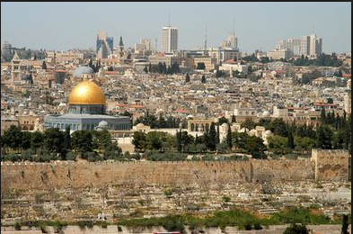
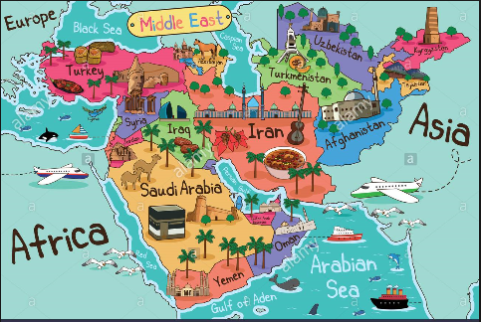
Middle East

Slide 2
KWL
On your KWL chart please record down what you know or think you know about the Middle East.
What questions could you develop that we could focus on in learning about this part of the world?

Slide 3
Know
Want to Know

Slide 4
Know
Want to Know

Slide 5
Objective
Geographers will be able to analyze geographic features of the Middle East through a map and question activity.

Slide 6
Objective
Geographers will be able to analyze geographic features of the Middle East through a map and question activity.
Geographers will be able to identify the countries of the Middle East through the labelling of a map and answering questions.
First, get out your geography challenge from Monday….
Look over your maps and individually answer the critical thinking questions.

Slide 7
Objective
Geographers will be able to analyze geographic features of the Middle East through a map and question activity.
Directions:
Get out your Geography Challenge- please work to finish that.
If you finished that Friday then please finish your map activities from yesterday.

Slide 8
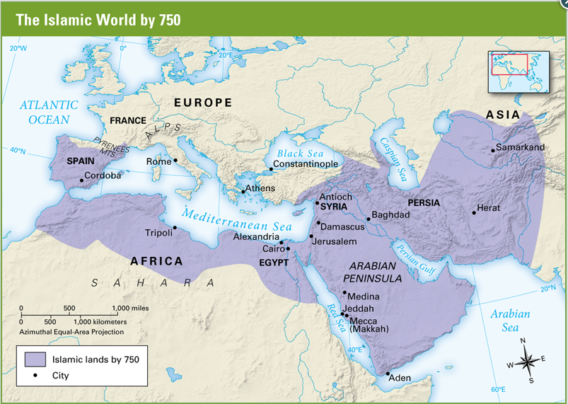
Geography Challenge- Read the text and answer and label your maps. Just the front side.

Slide 10
Why would Islam be able to spread quickly out of Arabia?
What strengths does this area have? Weaknesses for Muslims?

Slide 11
Middle East Map- Locate and label the major geographic features of the modern Middle East.
Retrieve an Across the Centuries pages 522-524
Follow the directions on your paper to complete your map.
This will be collected and assessed so as always give your best effort.

Slide 13
Map Questions
1. Are there any countries that you recognize or have heard of?
Any that are new to you?
What stands out to you from this map of the Middle East?
Which countries do you think are the main powers in the region? Why?

Slide 14
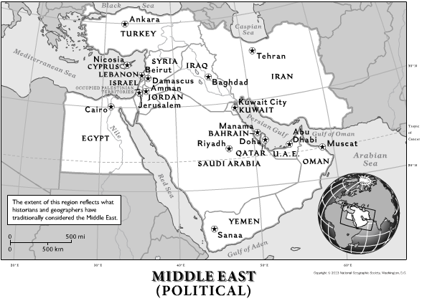

Slide 16
Modern Middle East
Historians will be able to identify and describe important characteristics of the modern day Middle East.

Slide 17
1. Where does the term “Middle East” come from? What term would you use to identify this area of the world?
2. What makes this region of the world so important to study and understand?
3. What are the dominate ethnic or cultural groups in the Middle East?
4. What is the dominate religion? Are there any other religions present in the Middle East?
5. How would you describe the climate in this part of the world? Explain.
6. What environmental/geographic problems do people face who live in this region?
7. How do people manage to overcome or deal with those geographic problems?

