Slide 1
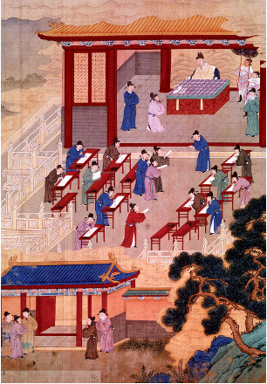
Political Developments in China
Which method of selecting officials led to the best leaders for China?

Slide 2
Warm Up
Suppose you had to choose someone to make decisions for you. Which of the following people would you trust most to make important decisions for you?
Someone from another country
Someone who is rich
Someone who is considered an excellent student
What is your reasoning for your selection?

Slide 3
Historians will be able to describe and evaluate the different forms of China’s government through a reading response and simulation.
Just as you and your peers had different ideas about who you would trust to make decisions for you, Chinese emperors sometimes disagreed about the types of officials to help them govern.
In this lesson, you will learn about three different ways Chinese emperors chose people to help them rule a vast and diverse country.

Slide 4
In this lesson you will learn about the different imperial dynasties that ruled over China.
What does imperial mean?
What is a dynasty?

Slide 5
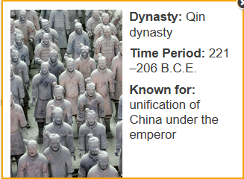
In this lesson you will learn about the different imperial dynasties that ruled over China. Prior to China’s emperors, China was ruled much in the same way as Medieval Europe, with powerful nobles influencing what the kings or emperors did (Shang and Zhou dynasties)

Slide 6
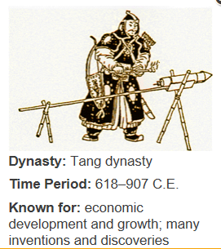
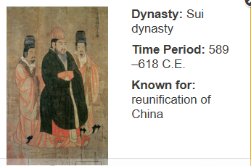
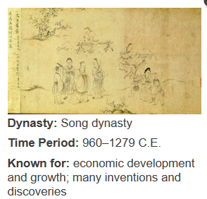
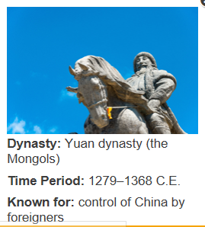
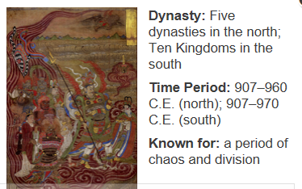

Slide 7
Read Section 15.2
According to the Mandate of Heaven, when can people overthrow the emperor?
What is a bureaucracy? What happened when the bureaucracy in China became corrupt?

Slide 8
What happened to China when the Han dynasty lost the Mandate of Heaven? Who reunited China?
Draw a simple symbol for the term or concept you believe is the most important from this section. Include a label for your symbol.

Slide 9
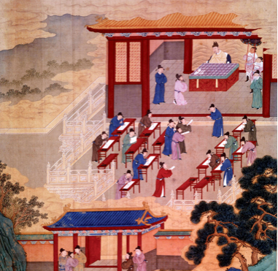
Throughout Chinese history, emperors have appointed different types of people to help them govern.
During different eras, emperors have
chosen aristocrats, or wealthy members of society
selected scholars, or
appointed foreigners.
In this lesson, you will each be assigned a role and will debate the advantages and disadvantages of appointing various types of people as government officials.

Slide 10
Read your assigned role
Through this activity, the Emperor will be choosing which group—Foreigners, Aristocrats, or Scholars—will make the best leaders for China.
As each step is revealed, follow the corresponding directions for your role on the Handout.

Slide 11
Step 1 Discuss which qualities will make good leaders for China.
Emperor: Sit on your throne, where you will meet with your Chancellors.
Chancellors: You are advisers to the Emperor and must kneel before him or her.
The rest of you should meet in separate groups to discuss the reasons why your group would make the best government officials: Aristocrats Foreigners Scholars
Everyone: Follow the directions from Step 1 on your role cards for the discussion.

Slide 12
Step 2 Participate in province meetings.
Aristocrats, Foreigners, and Scholars: Go to your assigned province. Use the information you have recorded to answer the Chancellor’s questions.
Emperor: Send the Chancellors to the provinces. Then make a list of jobs that government officials must do.
Chancellors: Meet with each group of Foreigners, Aristocrats, and Scholars. Once you have gathered the necessary information, return to the Emperor.

Slide 13
Step 3 Listen to the Chancellors’ recommendations and the Emperor’s choice.
The Emperor asks each Chancellor for his or her recommendation and one argument to support it.
Once all arguments have been heard, the Emperor chooses the group to serve as the leaders, or officials, of China.

Slide 14
Debrief Aristocrats
Which argument do you think was strongest for choosing the Aristocrats?
Very wealthy so they can fund government projects or raise armies
Traditionally held positions as officials=hands on experience
Would be loyal because they have enough money so they wont accept bribes
Which argument was strongest against choosing the Aristocrats?
Use their power to only help themselves instead of the country
They have the resources to fight against the emperor
Not as educated as scholars

Slide 15
Scholars
Which argument do you think was strongest for choosing the Scholars?
Went through school and had training so they are more responsible (good work ethic)
Make better decisions because they are smart/educated
Write down history-> make the emperor look better
They understand and learn from the past
Which argument was strongest against choosing the Scholars?
Can make decisions but may not have the financial means to support those decisions
Not really street/common sense smart
They could be so involved in learning and books that they are unaware of what is happening in the real world

Slide 16
Foreigners
Which argument do you think was strongest for choosing the Foreigners?
Would be fair in decisions because they have no bias towards any Chinese groups
Would be loyal to the emperor because they have no other ties, got their job from him/her
Would not take over government because the Chinese would not accept a foreign ruler
Ideas and technologies, world experiences from outside of China
Which argument was strongest against choosing the Foreigners?
they don’t speak the language of the country
Could be spies….trustworthiness is an issue
May be ignorant of how the government functions…or even the culture of China

Slide 17
How do you feel about the Emperor’s decision?
Which group do you think should be eligible for government positions? Why?

Slide 18
Debrief Aristocrats
Which argument do you think was strongest for choosing the Aristocrats?
Help the emperor and empire by using their land and wealth
They have traditionally held government jobs so they have hand-on experience
Wont take bribes because they are already wealthy
Which argument was strongest against choosing the Aristocrats?
They are not highly educated in government, at least not as much as scholars
Only know or care about the higher classes, small percentage of population
They could use their wealth to take over the empire/overthrow the emperor

Slide 19
Scholars
Which argument do you think was strongest for choosing the Scholars?
Highly qualified: smart and educated to make the best decisions
Write down history->understand history and make the emperor look good
Studied many different subjects like philosophy so they understand the proper ways of acting with power
Study the government and how it runs so they can use it effectively
Which argument was strongest against choosing the Scholars?
Books may be false leading for poor decisions (stuck in their ways and are very “by the book”
Too involved in learning and not aware of the “real world”
Depend too much on books for decision making

Slide 20
Foreigners
Which argument do you think was strongest for choosing the Foreigners?
Only group that has knowledge of the rest of the world
Bring new ideas, tech etc etc
Loyal to the emperor because they depend on him and they are new to town so know other loyalties
Least likely to overthrow the emperor , the Chinese won’t follow a foreign ruler
Which argument was strongest against choosing the Foreigners?
No clue about Chinese culture, it is very different
Spies and try to overthrow China
Trustworthiness is a concern

Slide 21
Aristocracy
1. Who were scholar-officials?
Scholars who were given government jobs only after passing a civil service exam to prove they were qualified.
2. The examination for scholar-officials was based on what body of knowledge?
The teachings of Confucius
Why did aristocrats continues to hold most government offices
They were given those jobs because their fathers and grandfathers had the jobs
They married into the emperors family
They received recommendations from other aristocrats in the government
They had the money, resources, and time to attend school and study for the exams

Slide 22
Meritocracy
1. What type of leaders did the government want by having them study the teachings of Confucius?
Officials who were respectful of their elders, and kind to people below them.
Act moral, rational, and able to maintain order
How did becoming a scholar change?
The government built schools to help educate lower class people.
Why did people want government jobs?
A sense of prestige, and privileges such as exemption from taxes and military service

Slide 23
Government By Foreigners
Why did the Mongols remove the civil service exam?
The Mongol leader, Kublai Khan did not think that taking tests was necessary for government officials.
Who did Kublai Khan choose to fill important positions? Why?
Relatives, other Mongols and foreigners because he could not trust the Chinese who he just conquered
What happened to scholars under the Mongols?
They could only be teachers or low-level government employees

Slide 24
Revival of the Civil Service Exam
Positives
Provided a well-organized government
Education of scholar-officials emphasized rational, moral behavior, justice, kindness, loyalty to the emperor, proper conduct, and the importance of family.
Values helped unify China
Gave poor men who were ambitious and hardworking the chance to be government officials
Ensured that government officials were trained and talented, not merely rich or related to the emperor
Negatives
Stood in the way of progress by not teaching and testing knowledge of science, math, or engineering
Confucian scholars had little respect for merchants, business, and trade; trade and business were not encouraged
Officials became set in their ways and did not change their view of the world

Slide 25
What was it like to take a civil service exam in Imperial China?
With your group develop three questions about what else you would like to know about the civil service exams in China.
We will read a text with primary sources which will provide us insight into what it was like to study for and take these exams. Passing these exams meant entrance into one of the most influential careers in all of China.

Slide 26
We will read a text with primary sources which will provide us insight into what it was like to study for and take these exams. Passing these exams meant entrance into one of the most influential careers in all of China.

Slide 27
In a six word summary….. What was it like to take a civil service exam?
How do these exams differ from assessments you take today?
How do these exams similar to assessments you take today?

