Slide 1
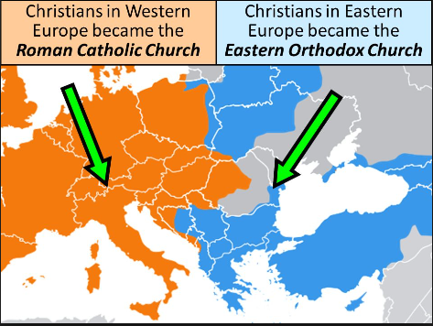
The Schism of 1054

Slide 2
Warm up
“You shall not make for yourself a graven image, or any likeness of anything that is in heaven above, or that is in the earth beneath…You shall not bow down to them or serve them.”
This is one of the Ten Commandments found in the biblical book known as Exodus. This passage created a conflict that led to the creation of two branches of Christianity.

Slide 3
Objective
Historians will be able to describe the events that led to the splitting of the Christian church through readings, class discussion, and a drawing activity.

Slide 4
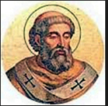
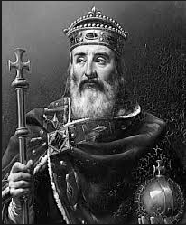
Different Perspectives
Half of the class will read the text from the viewpoint of Pope Gregory III and complete his side of the chart.
Half of the class will read the text from the viewpoint of Byzantine emperor Leo III and complete his side of the chart.

Slide 5
Read the article and complete the chart below.
Emperor Leo III
Pope Gregory III
Leo banned all use of religious images or icons fearing that people were worshipping religious icons as gods themselves.
Emperor Leo orders a policy of iconoclasm in which much religious art is destroyed. This angers the pope and many Christians who use icons in religious ceremonies. The Byzantines eventually allow icons.
Empress Irene
Pope Leo III
Charlemagne
Pope Leo refuses to recognize Empress Irene as the protector of Christianity because she is a woman. Instead he crowns Charlemagne as Holy Roman Emperor to protect Christianity.
This action outrages the Byzantines who believe that Byzantine emperors are the only rightful rulers of the remains of the Roman Empire. The Byzantine Empire came out the Roman Empire, thus Byzantines refer to themselves as Romans, Charlemagne did not.
Patriarch Cerularuius
Pope Leo IX
Cerularius/Byzantines close all churches within the Empire that worshipped with western ceremonies. The Pope excommunicates (bans from the church) the Byzantines who in return excommunicate the Pope.
The mutual excommunications result in a final split or schism between the Roman Catholic Church, and the Eastern Orthodox Church. They are friendlier now but remain separate institutions.

Slide 6
Quick Draw
On a sheet of loose leaf paper, draw an image/cartoon which represents what the Schism of 1054 was.
On the back explain what is in your cartoon and what your drawings represent.

