Slide 1
Themes in World History

Slide 2
Objective
Historians will be able to identify and describe the different themes of history through a reading and image analysis activity.
Historical themes are ways of making sense of world history by identifying patterns. Even though cultures may seem very different people have followed similar paths in how they have organized themselves and related to other groups.

Slide 5
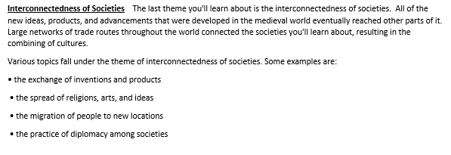

Slide 6
Human-Environment Interaction
Rise of Empires
Growth and Change in Societies
Development of Political Institutions and Ideas
Belief Systems
Interconnectedness of Societies
People must operate within the limits of the environment. Where people can live an how they support themselves. People also impact the environment. Technology has impacted how people interact with the environment
As human societies develop they begin creating more and more complex civilizations. Starting as small groups to small kingdoms and eventually some became empires.
How societies organize themselves. Throughout history, each society has developed its own rules and customs to govern behavior and help it function. Although these structures varied from culture to culture, they also had many things in common
Creation of political systems and forms of government. How countries or people practice and share (or not) power.
Ideas spread around the world leading to new philosophies and religions causing great social and political change.
Large networks of trade routes help to spread new ideas, products, and other advancements throughout the world.

Slide 7
Here, scientist Galileo (center) is on trial for suggesting the idea that Earth revolves around the sun.

Slide 8
The Great Market in the city of Tenochtitlán was a center of daily life for the Aztecs, another civilization that thrived in Mesoamerica.

Slide 9
The Chinese held exams for hiring scholar-officials to help the emperor rule.

Slide 10
What are some ways in which the themes of history impact your life?
At your tables come up with ways that these historical themes impact your lives today. Record your examples in the appropriate sections.
Then with your group write down 2-3 examples on post it notes and post them in the appropriate section on the white board.

