Slide 1
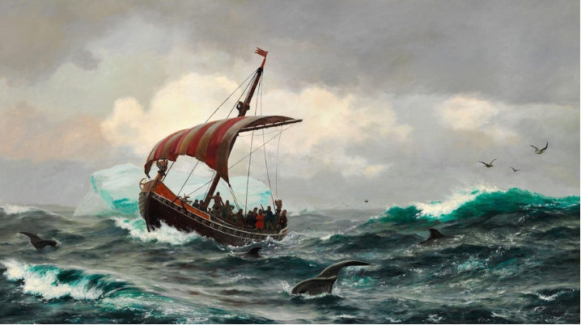
Vikings

Slide 2
Get a whiteboard and materials With your group develop a list of what you know about the Vikings.

Slide 3
Get a whiteboard and materials With your group develop a list of what you know about the Vikings.

Slide 4
Get a whiteboard and materials With your group develop a list of what you know about the Vikings.

Slide 5
Get a whiteboard and materials With your group develop a list of what you know about the Vikings.

Slide 6
Map activity- Make sure you have a historical atlas and answer the worksheet

Slide 7
Warm Up and Introduction Historians will be able to describe important characteristics of the Vikings through a source analysis and map activity.
One of the most dramatic events in early medieval history was the sudden movement of Scandinavian peoples into Western Europe, the Mediterranean, and down the rivers of Eastern Europe.
Wherever these raiders and settlers, often called "Vikings" or "Northmen," went, they had an enormous impact on the people living there.

Slide 10
We will first analyze some sources from that time period. Questions we will seek to answer as we learn about the Vikings….
What do historical sources say about Vikings? Do historical sources portray the Vikings accurately?
How does this image compare to modern day sources?
What was Viking culture like?
Why did Vikings expand across Europe? Why were they so successful?
What short term and long term impacts did the Vikings have on Europe?

Slide 11
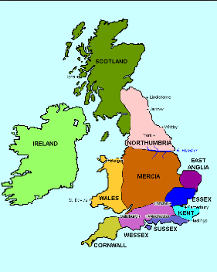
Document A- Anglo-Saxon Chronicles
1. What sort of document is this, and what do you think was its purpose?
2. Describe the activities of the Vikings (called “heathens” or “Northmen). What do they do? Is any reason given to explain their activities?
3. The author lived at an abbey or monastery. How might he view non-Christians?
4. What view does he seem to hold of the Vikings? Why?
5. Might his view be biased? Why or why not?
6. How does this source describe what is happening in other areas of Europe?

Slide 12
Document B
1. What sort of document is this, and what do you think was its purpose?
2. Describe the activities of the Vikings (called “heathens” or “Northmen). What do they do? Is any reason given to explain their activities?
3. The author lived at an abbey or monastery. How might he view non-Christians?
4. What view does he seem to hold of the Vikings? Why?
5. Might his view be biased? Why or why not?

Slide 13
Document C- Letter from Alcuin
Purpose of Source
How does it describe the Vikings?
Any reasons for why the Vikings act the way they do?
Is the source reliable?

Slide 14
Warm Up – Write on a post it note
In one word how would you describe the Vikings based on our historical sources?
Then explain why you chose that word.

Slide 15
Retrieve a Historical Atlas and open to page 67
Draw the routes that Vikings travelled
The areas that Vikings raided
The areas that Vikings settled

Slide 17
Objective: Historians will be able to describe and evaluate the characteristics of the Vikings through a reading response and class discussion.

Slide 18
Warm Up
Have out your Viking Maps (D 6) and answer the prediction questions/share out your prediction questions

Slide 21
Where do Vikings come from? What countries?
Why would Vikings be good seafarers?
Why might the Vikings feel the need to travel to other places?
What areas did Vikings settle?
Why would Vikings target monasteries and churches?

Slide 22
Read the Introduction and Causes sections
Why did Vikings travel throughout Europe?
Were searching for land, resources, and trade
Life was hard in Scandinavia with a lack of farmland and harsh climate
Population increases led to people having to look elsewhere
Vikings also wanted more opportunities as warriors or farmers elsewhere
Why are is this just a theory? Why is it not 100% certain?
Knowing this background does it change your perception of the Vikings?
Who else in history does this remind us of?

Slide 23
Read the Raids section
How did Vikings conduct their attacks?
Hit and run tactics- they would attack a village (kill, loot) then sail away before local forces could show up to fight.
What were their primary targets? Why?
Churches and monasteries because they were located near coasts and rivers, undefended, and had lots of treasures.
Why were they so successful?
Longboats: could sail over oceans, but also up rivers. They were fast and nimble and could avoid other ships and outrun them. They could appear suddenly at virtually every town or city in Western Europe.
If you were a ruler back then what would your strategy be to deal with Viking raids?

Slide 24
Settlements
Why would Vikings want to settle in some of the lands they raided?
They wanted to farm
To create trading centers
Bases for further raids
What areas did they settle?
England, Ireland, Iceland, Normandy (France), Russia
Does this influence your thinking about how the Christian sources describe the Vikings?

Slide 25
Assimilation (Blending In)
Why did Viking attacks eventually end?
They converted to Christianity
Christian leaders developed better defenses such as castles, and quick response forces
Are there any influences from Viking culture?
Trade networks spread across Europe
Towns and cities were originally Viking settlements
Some language and words are from the Vikings
Some law codes
Poetry and music

Slide 26
Brain Pop
Record down any aspects of Viking culture that we have not learned about.
Is the description of Vikings as “savage, pagan warriors” accurate?

