Slide 1
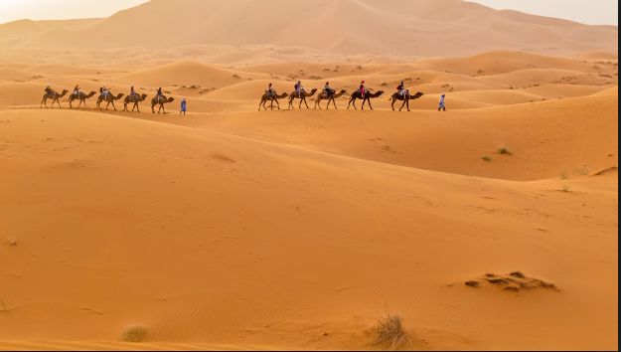
Early Arabia

Slide 2
Historians will be able to describe the early cultures of Arabia through a reading and response.
We will learn about the early cultures of Arabia
We are going to learn more about the Muslim prophet Muhammad and his early life in Arabia.
You will also learn about the origins of Islam, and how Islam spread throughout the Middle East, southern Asia, northern Africa, and parts of Europe in the 7th and 8th centuries.

Slide 3
The Cultures of Early Arabia
As you read through each section of the text, highlight the different cultural characteristics and influences on the peoples of early Arabia.
After each section you will work with your group to sort those important details into categories on a chart.

Slide 6
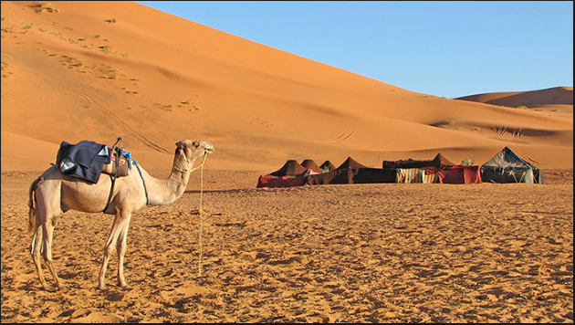
Geography
Only small areas are fertile enough to support farming
Many people are nomads moving their livestock from place to place searching for water and plants
Culture
People live in clans (families or extended families)
Led by older men, clans provide security and support, this is their form of government because there is no central government
Clans fought constantly in hit and run raids. They fought over land, water, possessions, and even women
They were very proud of their independence and honor, and would seek revenge if a member of their clan was killed by another clan .
They all had a common language (Arabic) and would compose poetry which was very important to their culture.
Economy
People herded animals
Oases were places people would meet in search of water, and as a result would communicate and trade at these places.

Slide 10
Geography: Repeat: People traded around oases
Religion:
Mecca became a major religious and trade center
Christianity and Judaism were spread over trade networks
Economy
Sea and trade routes connected Arabia to the outside world
Trade in animals, textiles, metals, ivory, spices, and perfumes was most common
People travelled in camel or donkey caravans from city to city

Slide 13
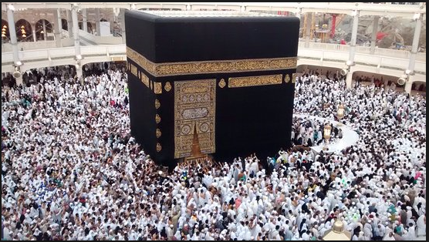
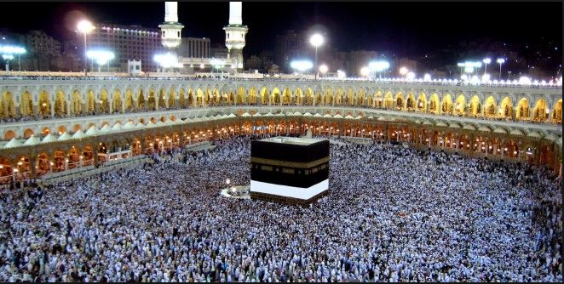
Religion
People would visit a shrine called the Ka’bah which was a cube-shaped building
Inside were statues or idols of many different religions
It was common for people to believe in multiple gods (polytheism)
Many Arabs converted to Christianity and Judaism, the belief in one god (monotheism)
but they would blend their old beliefs with their new religion

Slide 14
Warm Up
Each person at your table come up with one word that you think best describes the people of early Arabia.
Use a whiteboard

Slide 15
Exit Ticket- Early Arabia
Write a summary to each prompt or question by incorporating the listed vocabulary words.

Slide 16
Rise of Islam
Historians will be able to describe the events that Muslims believe led to the creation of Islam through a reading and response, audio, and scavenger hunt activity.
Understanding how a religion begins provides scholars with insight into why its followers practice certain ceremonies or have certain beliefs.

Slide 17
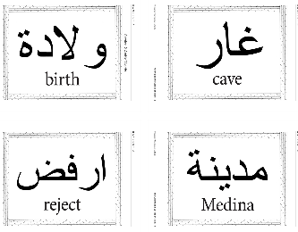
Notice the Arabic words on the walls. Arabic is sacred to Muslims. The Qur’an, or Muslim scripture, is most commonly printed and memorized in Arabic.
Although portions of the Qur’an were written in Muhammad’s time, a single written compilation was prepared about 15 years after his death.
During Muhammad’s lifetime the Qur’an was preserved through an oral tradition.

Slide 18
Directions
Clock buddies
Have a clip board and a textbook
After each audio clip you will move to the words or terms that you feel best represent what you just heard.
Then write down those four words
Then using those words and your text, write a summary about that particular section of the Islamic creation story.

Slide 19
Muhammad’s Early Life
During the medieval period, many people couldn't read or write. Before texts like the Qur'an were written, people heard about them from storytellers.
Listen carefully, just as the people of the Arabian Peninsula did before the Qur'an was written down. You may want to follow along by looking at Section 7.3, Muhammad's Early Life, in the History Alive Textbook.

Slide 20
Get up with your partner and try to find four words that best match up with the part of the story you heard.
Birth Cave Reject Medina Orphan
Gabriel Followers People of the Book Trader
Allah Boycott Battles Marriage Qur’an
Night Journey Last Sermon
Birth, Orphan, Trader, Marriage
Write a summary of Muhammad’s Early Life, try to incorporate words that you gathered.

Slide 21
Bonus Question
According to the Qur’an, how might Muhammad have been prepared in his early life to become a major religious leader/figure?

Slide 22
Get up with your partner and try to find four words that best match up with the part of the story you heard.
Birth Cave Reject Medina Orphan
Gabriel Followers People of the Book Trader
Allah Boycott Battles Marriage Qur’an
Night Journey Last Sermon
Cave, Gabriel, Allah, Qur’an
Where was Muhammad?
Praying in a cave when he was visited by the angel Gabriel
What does Muslim mean?
“One who surrenders to God”
What is the holy book of Islam? What is in it?
The holy book of Islam is the Qur’an. Muslims believe it contains messages from God that Muhammad received from the angel Gabriel.

Slide 23
Listen carefully, just as the people of the Arabian Peninsula did before the Qur'an was written down. You may want to follow along by looking at Section 7.5, Muhammad's Teachings Meet with Rejection, in the History Alive Text.

Slide 24
Get up with your partner and try to find four words that best match up with the part of the story you heard.
Birth Cave Reject Medina Orphan
Gabriel Followers People of the Book Trader
Allah Boycott Battles Marriage Qur’an
Night Journey Last Sermon
Reject, Followers, Boycott, Night Journey
What did Muhammed teach when he preached to the Meccans?
That everyone must worship one God.
That all believers were equal, and that the rich should share their wealth with the poor.
He urged Meccans to care for orphans and the poor, and to improve the status of women.
Why did Mecca’s leaders try to prevent the spread of Muhammad’s message?
Mecca’s leaders did not want to share their wealth, and they feared that he might want to seize political power. Merchants feared that people would stop visiting the Ka’bah and would make Mecca poorer.
Why is Jerusalem a holy city for Muslims?
Muslims believe that Jerusalem is the site of Muhammad’s Night Journey where he met and prayed with earlier prophets such as Abraham, Moses, and Jesus before being guided through heaven and meeting Allah.

Slide 25
Listen carefully, just as the people of the Arabian Peninsula did before the Qur'an was written down. You may want to follow along by looking at Section 7.6, From the Migration to Medina to the End of His Life, in the History Alive Text Text.

Slide 26
Get up with your partner and try to find four words that best match up with the part of the story you heard.
Birth Cave Reject Medina Orphan
Gabriel Followers People of the Book Trader
Allah Boycott Battles Marriage Qur’an
Night Journey Last Sermon
Medina, People of the Book, Battles, Last Sermon
Complete your timeline using the audio and your textbook

Slide 28
619 CE: Muhammad’s uncle Abu Talib dies and Muslims come under more attacks in Mecca
622 CE: Muhammad and his followers leave on the hijrah
622-628: Muhammad develops a new community in Medina
624: Fighting breaks out between Meccans and Muslims
628: Meccans make a truce with Muslims
630: Muhammad’s army captures Mecca; he rededicates the Ka’bah to Allah
632: Muhammad delivers his Last Sermon

Slide 29
Exit ticket
Merchants had to communicate with other merchants and family to run their businesses over long distances. These letters provide historians with a great deal of information as to what life was like then, what people thought, and how people interacted.
Suppose that you are an Arab merchant living in the late 7th century. You have just traveled to Mecca and Medina for business and have met Muhammad and his followers. Write a short letter to a family member or a friend telling about your experience. In your letter, be sure to explain who Muhammad is and what he is teaching.

Slide 30
Exit Ticket- Defend the following statement by writing a paragraph using information learned in class.
The birthplace of Muhammad was important to the development of Islam.

Slide 31
Beliefs and Practices of Islam

Slide 32
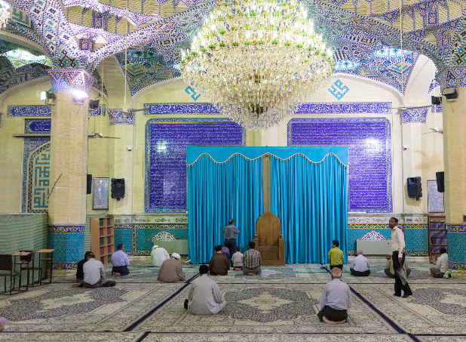
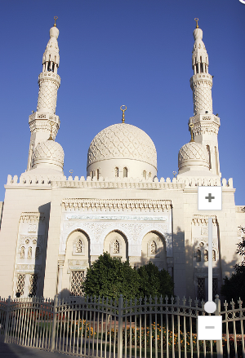
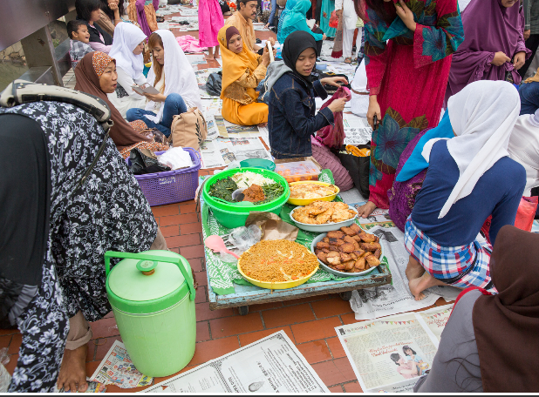
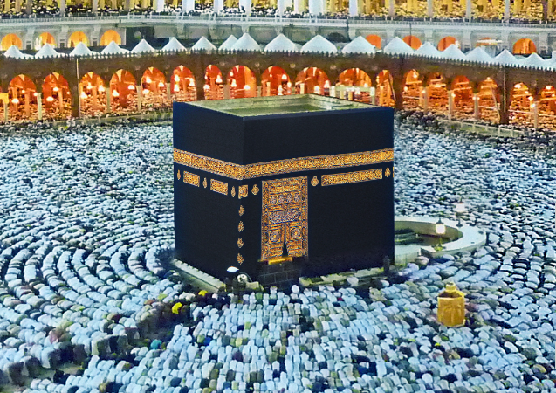
Warm Up

Slide 33
Objective
Historians will be able to identify and describe the important beliefs and practices of Islam through a gallery walk activity and through the creation of an illustrated diagram.
Today’s goal: Develop questions about Islam; Compare Islam with other religions; and complete your research on your specified aspect of Islam.
Today- Research poster
Friday- Create Poster
Monday – Gallery Walk
Tuesday- Video on Islam
Wednesday- Assignment
Thursday- Quiz on Islam and Early Arabia (C8-C11)

Slide 34
Background
1. Where can Muslims be found in the world today?
Middle East, North Africa, Indonesia, and pretty much every continent.
2. What are some of the similarities and differences between Islam and Christianity and Judaism
Similarities
All are monotheists,
all trace their heritage back to Abraham,
their scriptures include many of the same figures (Adam, Noah, Moses)
Believe that God revealed messages to many of the same religious figures
Differences
Judaism: Waiting on the Messiah, do not believe Jesus was the son of God, do not think the changes that Jesus and Muhammad created are necessary
Christianity: Believe the Jesus was the son of God
Islam: think that Jewish leaders and Jesus were important prophets, believe Jesus was not the son of God, Believe the Qur’an contains the final messages from God and how God wants his people to act and worship.

Slide 35
Directions
When you get into your groups record down which topic you have and who will be responsible for which job.
Begin reading your assigned text and answering your questions.
Disclaimer: When preparing and designing your posters keep in mind that Muslims find it highly offensive for images of Allah or Muhammad to be made. They believe that any images made of them is an insult to how holy they are. So out of respect for Muslim’s beliefs please do not draw any images of Allah or Muhammad.

Slide 36
Exit Ticket
Examine the images on your paper and connect at least one important characteristic of Islam to it. Explain how it connects.

Slide 37
Objective: Historians will be able to describe and evaluate the beliefs and practices of Islam through a video activity and exit ticket.
Have out your Islam packet and the picture assignment you had yesterday.

Slide 38
Which belief or practice of Islam do you think has the most significant impact on how Muslims live their daily lives?
Stand up next to the poster that represents that particular Islamic belief.

Slide 39
After viewing the video, which belief or practice do you think has the biggest influences on Muslim’s daily lives?
Write your response on your exit ticket.
If you changed your opinion then briefly explain why it changed.
If it stayed the same then what in the video led you to keep your opinion the same.

Slide 40
Qur’an
1. What is the Qur’an?
The Qur’an is Islam’s sacred book and is considered to be the word of God. In the Qur’an, God describes his laws and moral teachings.
What is the Sunnah?
The Sunnah, or “practice,” is the example set by Muhammad during his lifetime.
2. What is the difference between the Qur’an and the Sunnah?
The Qur’an is believed to be the word of God while the Sunnah is guidance on how to act based on Muhammad’s example.
3. How are the hadith related to the Sunnah?
The Sunnah contains precedents of behavior set by Muhammad. Hadith are written accounts of Muhammad’s actions that illustrate the Sunnah.
4. How are the Qur’an and the Sunnah related to the Five Pillars of Islam?
The Qur’an provides general commands to perform these five duties, and the Sunnah explains how, using Muhammad’s example

Slide 41
First Pillar: Shahadah-Declaration of Faith
1. Explain the meaning of the two parts of the Muslim shahadah.
“There is no god but God….” “…and Muhammad is the messenger of God”
Muslims believe in only one God which makes them monotheists. identifies Muhammad as God’s messenger or prophet.
2. According to Muslims, who is Allah?
Muslims believe Allah is the one, all-powerful God who created the universe. Muslims pledge to not only believe in God but to pledge their submission to God.
3. Provide some examples of how the shahadah influences the daily lives of Muslims.
Muslims say this phrase as a way to give themselves luck
Muslims whisper it to their babies, before taking a test or having an interview.
4. What do Muslims believe about angels and about judgement?
Muslims believe that angels do Allah’s work throughout the universe. They believe that everyone will face God’s judgment and that those who properly follow Islam will go to paradise and those who have done evil will go to hell.
5. How does shahadah compare to the practices/beliefs of Judaism and Christianity?
Jews and Christians also believe in angels and also in a final judgement.
They are also monotheists believing in the same God

Slide 42
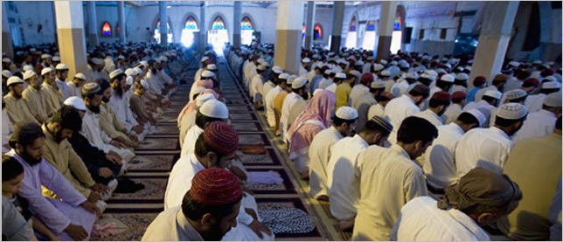
The Second Pillar Salat=Daily Prayer
1. What is the purpose of salat?
Salat is the Muslim daily prayer ritual that emphasizes religious discipline, spirituality, and closeness to God
2. Where and how often do Muslims pray?
Muslims worship 5 times daily, and can pray anywhere as long as they face Mecca. Though praying in a mosque is preferred.
A person called a muezzin makes a call to prayer over a loudspeaker or shouts to the community to inform/remind them that it is time to pray.
3. Describe at least three of the rituals Muslims practice in their daily prayers.
perform a ritual washing of hands, face, arms, and feet;
form lines behind a prayer leader called an imam (if in a mosque);
face in the direction of Mecca;
proclaim “Allahu akbar!” (“God is most great!”);
recite verses from the Qur’an; and kneel before God.
4. How does salat compare to the practices/beliefs of Judaism and Christianity?
They also go to religious houses to pray. They can also pray anywhere, though overall there are no designated times of when to pray

Slide 43
The Third Pillar: Zakat=Charity
1. Why do Muslims practice zakat? What do they believe about it?
They believe that the money is purified when it is used for good things.
2. How much of their surplus wealth are Muslims expected to give to charity?
2.5%
3. What kinds of things does zakat pay for?
Soup kitchens, food, shelter, clothing, education (schools and libraries), orphanages, hospitals
4. How does zakat compare to the beliefs/practices of Judaism and Christianity?
Jews and Christians donate money to their churches, called tithes

Slide 44
Siyam
(8.7) The Fourth Pillar: Siyam=____Fasting_____________________________________
1. What is the name of the holiday when Muslims practice siyam?
Ramadan
2. When is siyam performed and for how long?
In the 9th month of the Islamic calander (an Islamic year is about 255 days long as it follows the cycles of the moon instead of the sun)
30 days
3. What rule about food do Muslims observe during this religious holiday?
Muslims do not eat or drink anything from sunrise to sunset
When the sun is down people may eat again, but young children, pregnant women and the elderly are allowed to eat during the day.
4. What does Ramadan encourage and teach Muslims?
It encourages generosity, equality, and charity. Fasting teaches self-control and makes them realize what the poor deal with everyday. During Ramadan people try to forgive, give thanks, and avoid gossip, arguments, and bad deeds.
5. At the end of Ramadan Muslims eat a big feast called Eid al-Fitr
6. Ramadan is similar in Judaism- During the holiday of Yom Kippur, Jews do not eat from sunrise to sunset
Christians give up certain foods or luxuries during Lent

Slide 45
Hajj
(8.8) The Fifth Pillar: Hajj= _________Pilgrimage _________________
1. What is the hajj and what values does it promote?
The hajj is the pilgrimage or holy journey Muslims make to Mecca. They are required to make the journey at least once in their lives unless they are too sick or old.
Promotes fellowship and unity in their faith.
2. What do Muslims do during the hajj?
Dress in simple white clothing
Go to the Ka’bah to pray, touch or kiss the shrine, and walk around it 7 times
3. What important sites to Muslims visit during the hajj?
They visit other sites such as two small hills
the Plain of Arafat to pray until sunset
Throw stones at a pillar that represents evil

Slide 46
Jihad
8.9) Jihad, which translates as ____________”to strive”___________
1. What does jihad traditionally mean in Islam?
A physical struggle with spiritual significance
2. How does jihad influence how Muslim’s live?
They used/use it to justify defending their territories or to conquer new lands
They are told not to force enemies to convert or to abuse the people they conquer/rule
So non-Muslims were generally allowed to continue with their religion
3. How does jihad relate to Muslims and their personal struggles?
It can also mean to overcome the challenges of life and become a better person.
For instance giving up a bad habit, getting an education to improve your life, or working to improve society

Slide 47
Shari’ah
(8.10) Islamic Law: Shari’ah
1. What is shari’ah and how did it develop?
The collection of Islamic laws that are based on the Qur’an and Sunnah
It covers the duties and responsibilities of Muslims
2. How does shari’ah guide Muslim life?
It guides their personal behavior
They are forbidden from eating pork, drinking alcohol, or gambling
Women should dress modestly, though this varies from country to country
3. How has shari’ah changed over time?
When many Islamic countries were taken over by Europeans, the laws resembled those found in Europe
Turkey has removed many Shari’ah laws
Saudi Arabia and Iran still use Shari’ah law as their main set of laws
Others like Egypt and Pakistan have a mix of Shari’ah and modern laws

Slide 48
Let’s Learn About Religions: Islam
Historians will be able to describe and evaluate the key characteristics of Islam by viewing a video and responding to prompts.

Slide 49
Objective: Historians will be able to identify and describe important characteristics of Islam through a Islamic star diagram, and student created quiz.
Warm Up:
Look over your notes on Islam and on your whiteboard make a list of ways that Islam impacts how Muslims live day to day.

Slide 50
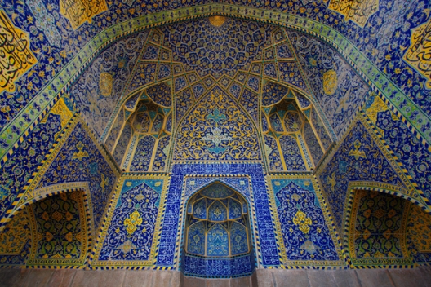
Islamic Star Diagram
Islamic art is incredibly precise and intricate.
To experience a bit of this art form you will design a star diagram that will describe the important characteristics of Islam.

Slide 51
For each of the eight sections of the star below, write 1-2 sentences that explains that belief or practice of Islam. Then create one simple symbol or illustration to help explain it. Place your explanations and illustrations in or next to the appropriate section of the star.
Out of respect of Muslim culture do not use human or animal figures in your illustrations, or any representation of Allah or Muhammad. Use shapes, symbols, or plants to represent each aspect of Islam.

